Slide 1
ILL at the University of Liège: From Fee to Free
Forum for Interlending
February 8, 2023
François Renaville, Head of Library Systems
Fabienne Prosmans, Fulfillment and ILL Coordinator

Slide 2
Context and Facts

Slide 3
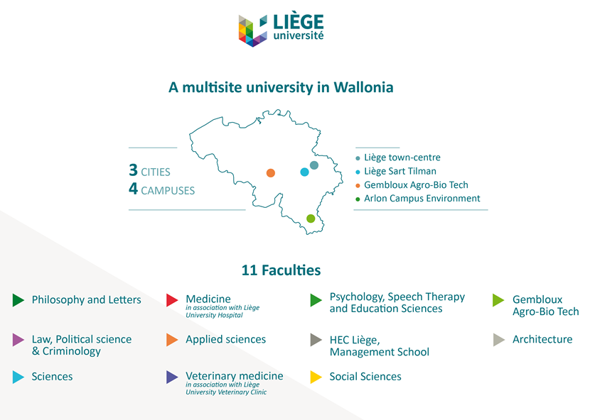
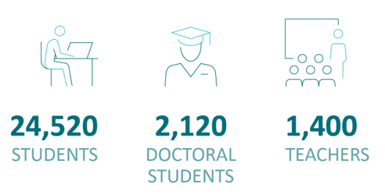

Slide 4
University of Liège Library
One library
composed of 15 branches
Staff: ca 110 people
Current situation for ILL:
Staff: 1 FTE (6 operators)
Coordinator: 0,1 FTE
Systems for ILL:
myDelivery (homemade, until 2015)
Alma (since 2015)
RapidILL (since 2020)
Impala (since 90s)
Subito (since 90s)
Paid service (until Spring 2020)

Slide 5
ILL - Major changes at ULiège Library since 2014 (1)
> 2014: 8 different ILL units (15 operators)
2015: 5 different ILL units (10 operators)
2018: 1 single ILL unit (6 operators)
Alma Resource Sharing Library
More collaboration between ILL operators
Harmonization of practices between operators
Operators take turns the ILL tasks (shared calendar)
Change was not easily accepted by everyone
Transparency is not always accepted
ILL work = preserve of some ILL operators
Cost and profit sharing (pooling of HR, revenues and costs)
Successful results, although change was underprepared

Slide 6
ILL - Major changes at ULiège Library since 2014 (2)
2020: Subscription to RapidILL for article and chapter delivery
Partially integrated with Alma
RapidILL = main supplier

Slide 7
ILL - Major changes at ULiège Library since 2014 (3)
2022: Full integration of RapidILL with Alma
If the request is accepted and processed in RapidILL, the scanned file is directly emailed from Alma to the requester (without intervention of an operator)
2022: Start of P2P resource sharing between Alma institutions in Belgium for physical items
Effective with the Free University of Brussels (ULB)
Test underway with the EC Library and KU Leuven

Slide 8
Towards a Free ILL Service

Slide 9
How it began…
2014: Outdoor activity of the Library Board members
To rethink the Library’s goals, missions and future
Library as a Service (LaaS)
2018: Mandate from the Board to carry out a feasibility study
Also a social aspect (students with low-income)
2019: Start of the study (completed only in 2022)
2020: Because of Covid-19 (and in parallel to the study), ILL service has become temporarily free of charge for ULiège students and faculty members
Great opportunity for a real pilot

Slide 10
(A) Feasibility study
Internal context
External context
Stakeholders
SWOT analysis

Slide 11
1) Internal context
(A) Feasibility study
Current organization of the ILL service
History and recent milestones
Recent major changes
ILL tools used so far
Facts and figures, statistics (since 2018)
Borrowing requests by format
Borrowing requests by Faculty
Requesters’ profile
Partners
Costs and revenues

Slide 12
2) External context
(A) Feasibility study
Survey among Belgian academic libraries
Paid or free service?
Literature review
Chronic subscription cost increases of many scholarly journals
Factors at that time:
Covid-19 crisis:
no physical delivery (for some months)
increase of digital delivery
RapidILL trial/subscription

Slide 13
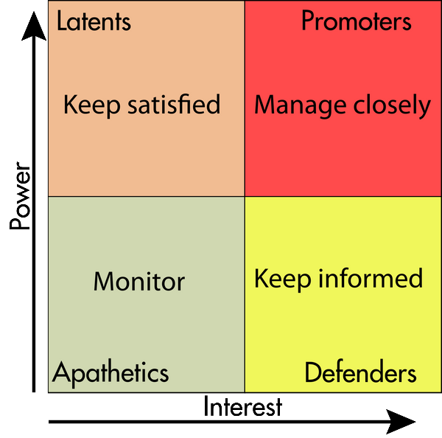
3) Stakeholders
(A) Feasibility study
Stakeholder Analysis
Primary stakeholders: most affected, either positively or negatively
Secondary stakeholders: indirectly affected
Tertiary stakeholders: impacted the least
And power-interest grid to identify
Stakeholders’ interests
Potential risks and misunderstandings (“me issues”)
Mechanisms to positively influence other stakeholders and the project
Negative stakeholders as well as their adverse effects on the project
Major risk at the level of the sponsor itself (until 2021)
Personal interviews with 8 key stakeholders
Min. 1 hour + recorded + transcribed + approved
Key stakeholders (mainly ILL operators) were in favor of a free ILL service!

Slide 14
4) SWOT Analysis
(A) Feasibility study
All internal and externals factors summarized in a SWOT analysis
= compilation of a project’s Strengths, Weaknesses, Opportunities and Threats
Strengths
Weaknesses
Opportunities
Threats

Slide 15
(B) Pilot during Covid19
From Spring 2020 (1st lockdown) to Spring 2022
Real statistics and usage data collected
First reactions and observations:
ILL operators could have an overview of what ILL would look like if it remains free
Patrons started to get used to a free ILL service

Slide 16
1) Usage data (1)
(B) Pilot during Covid19
Factors
Pre-Covid vs Covid vs post-Covid
Pre-RapidILL vs RapidILL
Paid vs Free

Slide 17
1) Usage data (2)
(B) Pilot during Covid19

Slide 18
2) First reactions and observations (1)
(B) Pilot during Covid19
Satisfaction of the end-users
Why should they pay for materials they need, but that the library doesn't hold?
Request increase seems to meet a need
Time saving for operators and secretaries in administrative tasks:
Operators should no longer
Care about how to invoice ULiège researchers and teachers
Add and manage the ILL fees for students in Alma
Secretaries should no longer produce invoices for researchers and teachers
No longer necessary to check if ILL fees have been paid

Slide 19
2) First reactions and observations (2)
(B) Pilot during Covid19
Some requests for books in physical format are very expensive because of the shipping costs (which can be very high if from abroad or outside the EU)
Since the service is free, a few students/faculty members request many books (several dozens) in physical format in a year
A few students/faculty members do not consult/loan the books they have requested
More requests to complete, but more automation (RapidILL and Alma 2P2)
Automation helps to balance the overload
The more automated, the cheaper!

Slide 20
Recommendations to the Board

Slide 21
Recommendations to the Board
Free ILL should be considered as a priority within the Library as a Service model
Free ILL service should be maintained for the ULiège community
With no limit for digital articles and chapters delivered via RapidILL
With an increase budget for postal charges
With no symbolic contribution to the costs
And Alma P2P for physical delivery should be encouraged

Slide 22
With some safeguards
ILL fees increased for some external patrons
Asking a contribution to the costs for physical item requests from abroad (from the 4th request) and frequent requests for journals that RapidILL cannot supply
Monitoring via Analytics
Purchase of a copy or of the ebook version (if any) in case of too high costs for delivery or item frequently requested
Monitoring via Analytics
From ILL to DDA (+ budget)
Raise awareness among patrons that there are always hidden costs (for the University)
In Alma letters
Free service is not a pipe dream (as long as costs remain under control)

Slide 23
Thank you!
François Renaville Head of Library Systems francois.renaville@uliege.be | Fabienne Prosmans Fulfillment and ILL Coordinator fprosmans@uliege.be

