Slide 1
Avoiding ILL fees across the EU border
Matt Voigts, PhD
Copyright & OA Policy Officer
FIL Online February 8, 2023

Slide 2
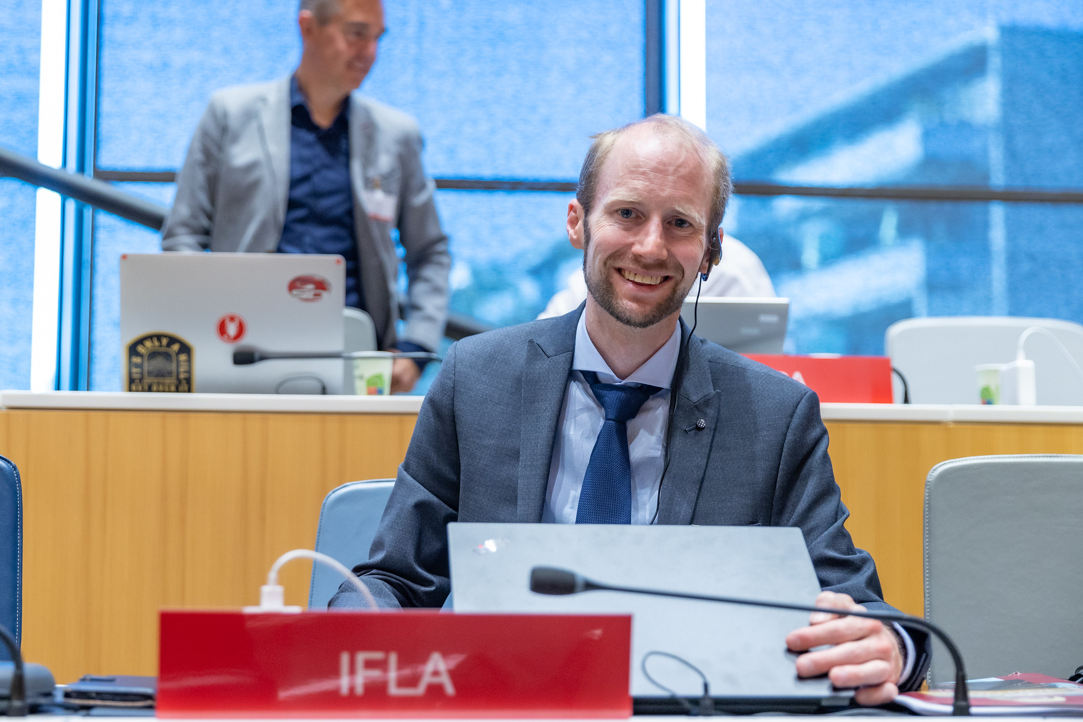
FIL 2023
What I do
Anthropology
Copyright & Legal Matters (CLM)
International advocacy (WIPO SCCR)
*I am not a lawyer and this presentation is not legal advice
Photo copyright: WIPO. Photo: Emmanuel Berrod. This work is licensed under a Creative Commons Attribution-NonCommercial-NoDerivatives 4.0 International License.
Notes:
[Note: this could be deleted or skipped over quickly]

Slide 3
FIL 2023
What EU fees aren’t you liable for Inter Library Loan?
Customs, duty, import or related fees.
What might you be liable for?
Delivery or processing fees.
Notes:
We became aware of complaints from libraries in the UK and Switzerland citing changes in regulation in 2021 that materials were being held, and payment was being requested.

Slide 4
FIL 2023
Why aren’t ILL materials liable for EU customs fees?
1. Media, cultural materials, and scientific instruments
Media Chapter 49 – EU Tariff
Books and recorded media, such as discs or tapes are free of customs duties
Cultural materials and scientific instruments
Chapter XI (‘Educational, scientific and cultural materials; scientific instruments and apparatus’) of Council Regulation (EC) No 1186/2009 of 16 November 2009 (EUR-Lex - 32009R1186), Article 42:
“The educational, scientific and cultural materials listed in Annex I shall be admitted free of import duties whoever the consignee and whatever the intended use of such materials may be.”
Notes:
https://booksellers.se/wp-content/uploads/2021/03/Brexit-FAQ-EIBF-FEP-2021-V6_210226.pdf

Slide 5
FIL 2023
2. Article 227: Pedagogic material and scientific equipment
(Article 250(2)(d) of the Code) /
Articles 219 to 235 of Regulation (EU) 2015/2446 (Union Customs Code Delegated Act or UCC-DA)
“Total relief from import duty shall be granted for pedagogic material and scientific equipment [if]
(a) they are owned by a person established outside the customs territory of the Union;
(b) they are imported by not-for-profit public or private scientific, teaching or vocational training establishments, and are exclusively used in teaching, vocational training or scientific research under the responsibility of the importing establishment;
(c) they are imported in reasonable numbers, having regard to the purpose of the import;
(d) they are not used for purely commercial purposes.
“Pedagogical” is not defined – ask your own country!

Slide 6
FIL 2023
Why aren’t ILL materials liable for EU customs fees?
3. Temporary Admission
Article 236 UCC-DA
“Total relief from import duty may be granted for goods… imported occasionally for a period not exceeding three months… [or] imported in particular situations having no economic effect in the Union.”
Notes:
https://eur-lex.europa.eu/legal-content/EN/TXT/HTML/?uri=CELEX:32015R2446&from=EN

Slide 7
FIL 2023
Returning goods to EU
When materials are brought back to the EU, they can be declared for release for free circulation as returned goods if they fulfil the conditions established in Article 203 UCC, namely:
The books must return to the EU within 3 years,
The declarant must apply for the relief,
The books must return in the same state in which they were exported, and
The declaration must attach the documents showing that these conditions are fulfilled.
Notes:
Source: emails with the EU Direct Contact Centre

Slide 8
FIL 2023
“Customs practices differ across Member States in three main ways: (1) customs declarations are submitted and processed in differing national IT systems; (2) implementation of customs legislation is not harmonised particularly as regards prohibitions, restrictions, and risk interpretations; (3) sanctions and infringements regimes vary significantly, with some Member States applying both administrative and criminal sanctions and others applying only the latter.”
From the executive summary of Hausemer, P.; Bosch, I.; Patroclou, N.; 2022, A Comparative Analysis of Member States' Customs Authorisation Procedures for the Entry of Products into the European Union, Publication for the committee on Internal Market and Consumer Protection, Policy Department for Economic, Scientific and Quality of Life Policies, European Parliament, Luxembourg. Available at: https://www.europarl.europa.eu/RegData/etudes/STUD/2022/734002/IPOL_STU(2022)734002_EN.pdf.

Slide 9
FIL 2023
Clearly indicate (as applicable) that the item is
Media
Pedagogical (and you are a library)
Temporary

Slide 10
Thank you!
Matt Voigts
IFLA Copyright & OA Policy Officer
matt.voigts@ifla.org
Notes:
If you’ve experienced challenges with these fees, please contact me! It could help us figure out where the problem areas are and how to improve advice!

