Slide 1
ILLs for NHS libraries
- a story of collaboration
Notes:
Hello and thank you for taking up my offer of a brief presentation on interlibrary loans in the NHS.
I have called this presentation “ILLs for NHS libraries – a story of collaboration” because it is the collaborative aspects of our work that I want to highlight.

Slide 2
The NHS library landscape
NHS libraries – probably over 200
NHS library services – managing one or more libraries
NHS library regional networks – 6
NHS libraries nationally – Health Education England
Notes:
NHS libraries (I believe there are at least 200 altogether) vary in size enormously – from quite large ones in major hospitals to something that’s really just a couple of shelves of books made available in a small in-patient unit or office.
NHS library services may manage just one of those libraries (eg Portsmouth) or several of them (eg HHLS). Some of them are dedicated to one NHS Trust whereas other serve more than one Trust.
Library Services cooperate with each other in regional networks some of which have shared catalogues/library management systems.
In addition, some infrastructure at a national level is provided by Health Education England.
It’s a little bit confusing!

Slide 3
Regional networks
South West, Thames Valley and Wessex
Kent, Surrey and Sussex
East of England
London
Midlands
North
Notes:
These are the 6 NHS library regions.
I am in the South West, Thames Valley and Wessex Region.
I work for Hampshire Healthcare Library Service which consists of 7 libraries across Hampshire from Southampton to Basingstoke, serving both Southern Health FT and Hampshire Hospitals FT along with local GP practices, Commissioning groups etc.
I’m part of a team within HHLS which covers 4 of the 7 libraries, all of which are in the Southampton and New Forest area.
Regionally, we share a catalogue and LMS across the south west of England called ‘SWIMS’ and this covers library holdings from Cornwall across to Hampshire and up as far as Buckinghamshire.

Slide 4
Inter-Network Collaboration
Notes:
So what does all this mean for our interlibrary lending?
Within SWIMS we use our shared LMS to process ILLs for our readers by ‘reserving’ titles across the region. We call this ‘intralending’. We use either our LMS or a separate ILL software product (in our case Clio) to place requests to NHS libraries in other regions. Clio can also place requests to the British Library for us but this is not yet available with the LMS.
The Inter-network Collaboration Scheme gives us a rota for which order to approach other regions so as to distribute workload evenly. So we approach libraries in our own region first and then the other regions in a certain order.
The situation is still rather fragmented with not all NHS libraries fully taking part for a variety of reasons. More information about how it works and plans to develop it in the future can be found in a 2021 report at resource sharing market review and options appraisal | Knowledge and Library Services (hee.nhs.uk)

Slide 5
ILL process
Search NHS catalogues
Reserve/request via LMS
Check copyright situation
Request from Reprints Desk if necessary
Search JISC Library Hub Discovery
Request from BL via Clio
Request from Universities via email
Search other catalogues
Notes:
The day to day process just involves searching a few regional catalogues and using either our own LMS or some ILL software (in our case, Clio) to send the request to another library. For journals, work is currently being done on a national NHS holdings list so that we will eventually have just one place to search for those.
Supply of loans is very quick and is mainly dependent on the postal service as most NHS libraries respond the same or next day. However, smaller libraries may not be staffed every day so that can make things take a bit longer.
Our ILL software (Clio) can also search and request from BL for us. To approach universities we email separately.
Everything between NHS libraries is free (just the cost of postage) so we exhaust those possibilities first in our search for ILLs. After that we search the JISC Library Hub Discover and this will give us BL and university locations.
BL obviously charge and universities will often charge us under the BL scheme. There are other cooperative groups we can use, though and I’ll mention those in just a moment.

Slide 6
National picture
Health Education England
Notes:
One of HEE’s major projects over the last couple of years, following the report I mentioned earlier, has been the introduction of the Knowledge and Library Hub (provided by EBSCO and incorporating a collection of approved information sources).
The ultimate aim is for all NHS library catalogues to be unified and to be linked to this system. This will give readers immediate access to book details and request forms alongside journal articles and other materials via OpenAthens authentication.

Slide 7
National picture
Notes:
SWIMS is the only catalogue linked to KLH at the moment, so our readers do have that facility – others will be added in due course.
My personal feeling is that this is not particularly easy to use – it produces too many results – so we do tend to encourage readers to come to us for help with whatever they are looking for.
A feature of the readers we look after in the NHS is their very wide range of information and digital literacy. Whilst a consultant physician who has done lots of studying in their career may be very happy to search for their own information and only need our service when they are really stuck; a healthcare support worker may feel that libraries are ‘not for them’ so we have to have a lot of support available.
I’ve digressed slightly from ILLs but that was just to demonstrate the forward direction of collaboration and sharing of resources across the NHS and how that’s working at the moment.

Slide 8
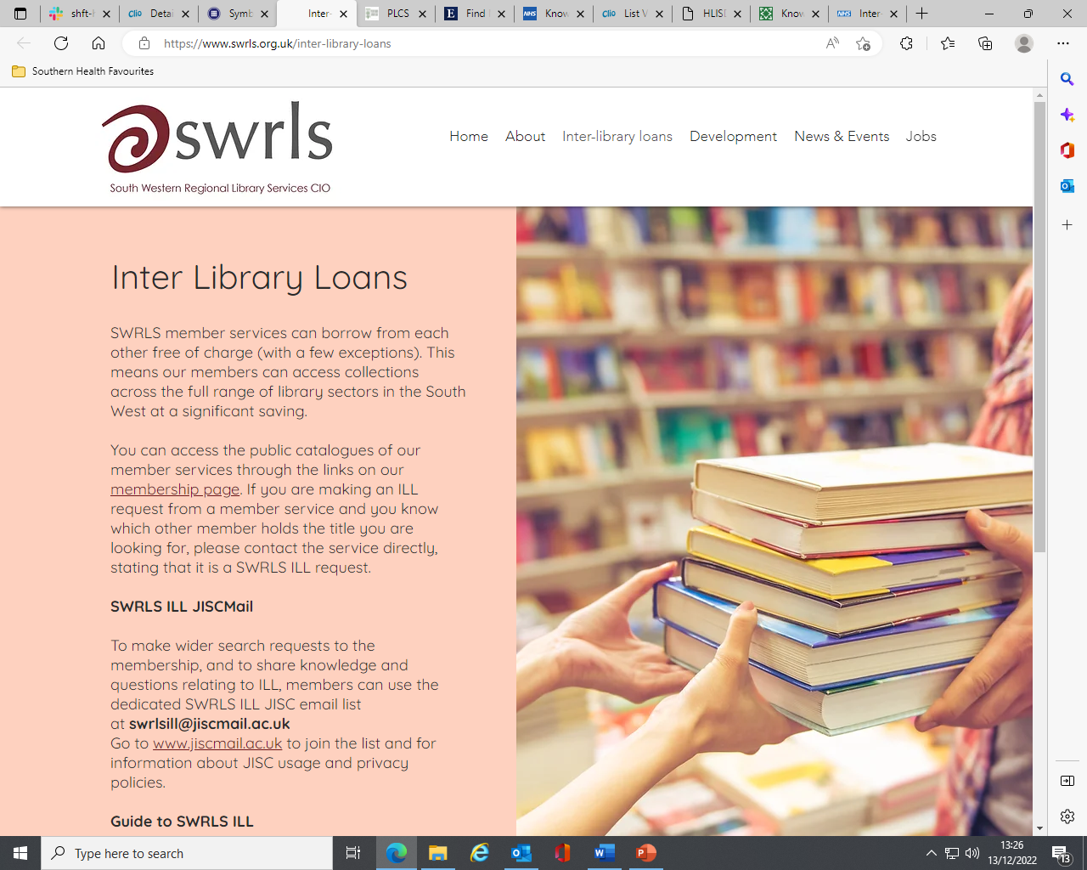
Other collaboration
South Western Regional Library Services
Psychiatric Libraries Cooperative Scheme
Notes:
Earlier I mentioned other opportunities for collaboration.
As the libraries I work in have a focus on mental health, we have been member of PLCS for many years. Recently our use of this has fallen off dramatically due to improved collaboration within the NHS itself. Where we would previously have needed to approach some libraries through PLCS, we now have access to those same libraries through our NHS networks.
An example would by the South London and Maudsley Trust Library at Bethlem Royal Hospital. Now that we can request from NHS London Region libraries easily we no longer need membership of PLCS in order to request from this library.
The most effective thing we have done is this year to join SWRLS and this has proved an enormous benefit. We have only had three actual book loans, but have requested more than 40 journal articles at the time of writing. This is probably around half of all articles we obtained from outside the NHS.
When searching the JISC Library Hub Discover, if we find a SWRLS location we will approach them first. Not all SWRLS members are covered by the Hub so we may also search catalogues individually.

Slide 9
Benefits of collaboration
Thank you to Bath University Library ☺
Notes:
I feel I should apologise to Bath University in particular as they have turned out to have access to a large number of the journals we need articles from!!
These are journal titles that we are rarely asked for and don’t come as part of our subscription packages, but they do pop up in literature searches from time to time. Whenever it is suitable for us to obtain a library privilege copy it is fantastic to have a network partner who has access to them.

Slide 10
The future
More inter-regional cooperation aided by national level initiatives
Keep battling on… ☺
Notes:
So where are we headed from here?
The plan for the NHS nationally is for more catalogues to be linked to the Knowledge and Library Hub and this will streamline inter-regional cooperation further.
We plan to continue membership of SWRLS as well.
Our computer systems can be a bit clunky and budgets are squeezed but we’ll keep battling on and thank you to all of those in the University sector who are so helpful to us! We hope to collaborate with you more in the future.
Thank you for listening and if you have any questions I’ll be happy to answer if I can ☺

