Slide 1
8 February 2023
Forum For Interlending 2023
Exceed your library users’ expectations with fast interlibrary loan
Ed Davidson
Senior Product Analyst – Resource Sharing
ed.davidson@oclc.org

Slide 2
Agenda
Overview of WorldShare Interlibrary Loan
Smart Fulfillment: Expediting turnaround times
The Express service
UK Specific topics
Questions…

Slide 3
The Worldshare Network

Slide 4


Slide 5
WorldShare ILL
How does it benefit your library?
  Extend your library’s collection with the world’s largest resource sharing network.
  Save time managing ILL requests.
  Deliver e-resources quickly and securely.
  Obtain items for your users faster with new smart fulfillment capabilities.
  Simplify ILL payments and charges with ILL Fee Management.
  Illustrate the value of your ILL services with reports and statistics.

Slide 6
Save time managing ILL requests
  Easy to use and to learn
  Simplifies your ILL processes
  by showing you other libraries’ holdings, policies, and fees before you make a request

Slide 7
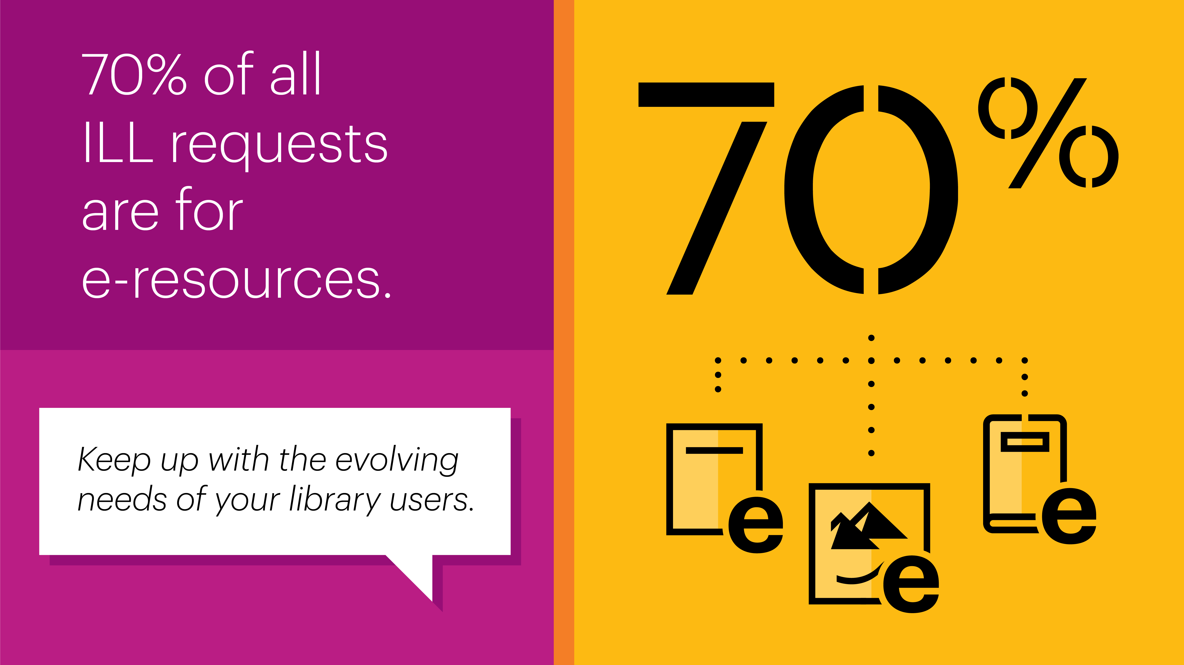
Notes:
.

Slide 8
WorldShare ILL
UK to UK statistics 2022
 | Copies | Loans | Total
Borrowing | 4081 | 4884 | 8965
Lending | 5791 | 6523 | 12314
Top Lender | 938 | 1484 | 2422

Slide 9
Deliver e-resources quickly and securely
  Requests for copies are often filled within 24 hours—sometimes in as little as 15 minutes
  Integrated with Article Exchange to deliver documents easily and securely

Slide 10
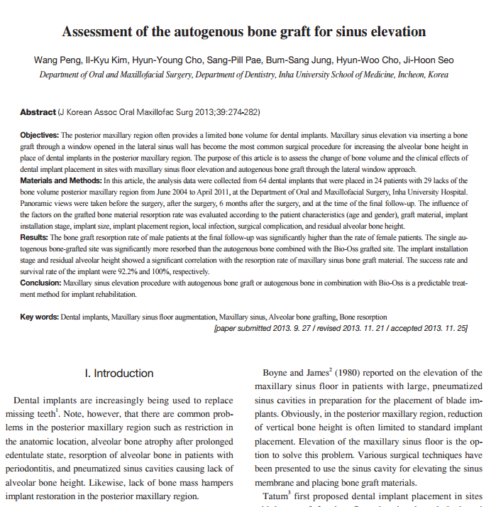
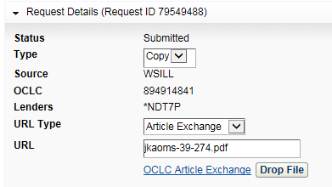

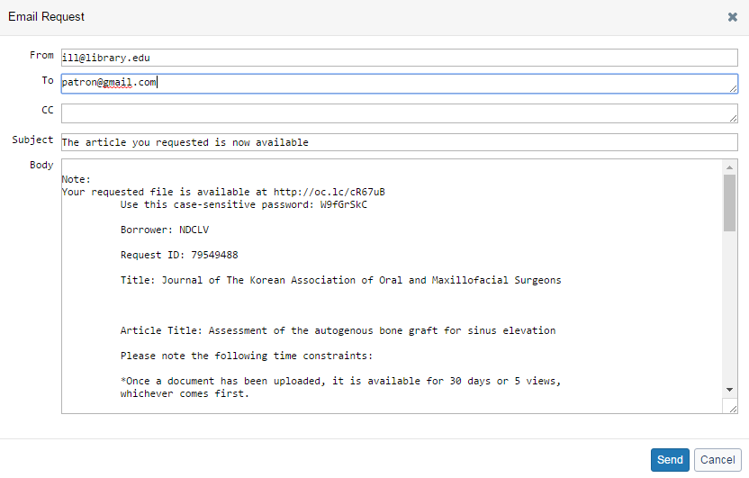
Deliver documents easily and securely

Slide 11

Simplify ILL charges and fees
with ILL Fee Management
  Easily reconcile all your fees on a monthly basis
  Free your staff from calculating fees, writing and mailing cheques, and following up on unpaid invoices

Slide 12
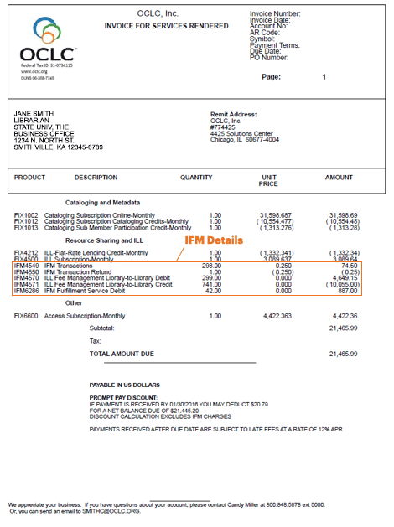
Simplify ILL charges and fees with IFM

Slide 13
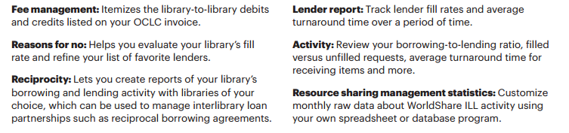
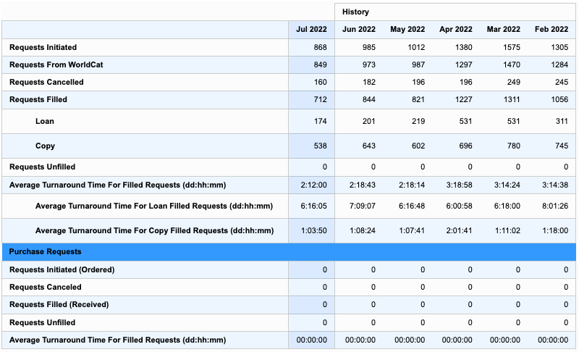
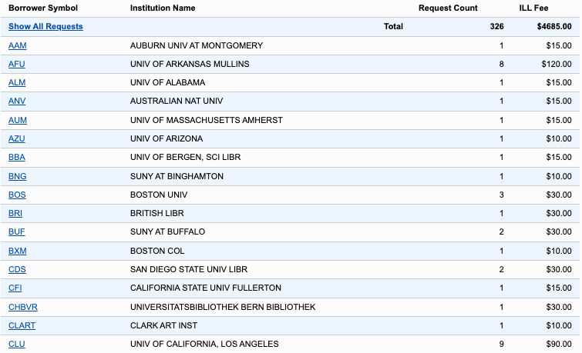
Illustrate the value of your library’s ILL
with reports
Sample: ILL Fee Management Lender Report
Sample: Borrower Activity Overview Report

Slide 14
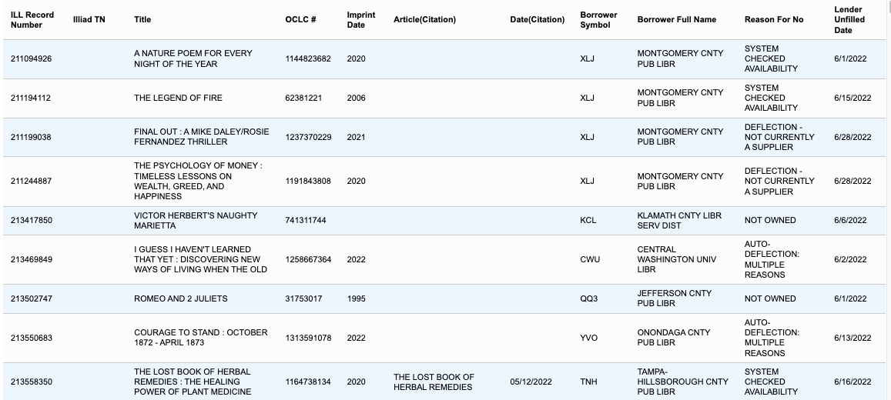
ILL reports can also help to optimize fill rates
Sample: Resource Sharing Lender Reasons for No report

Slide 15
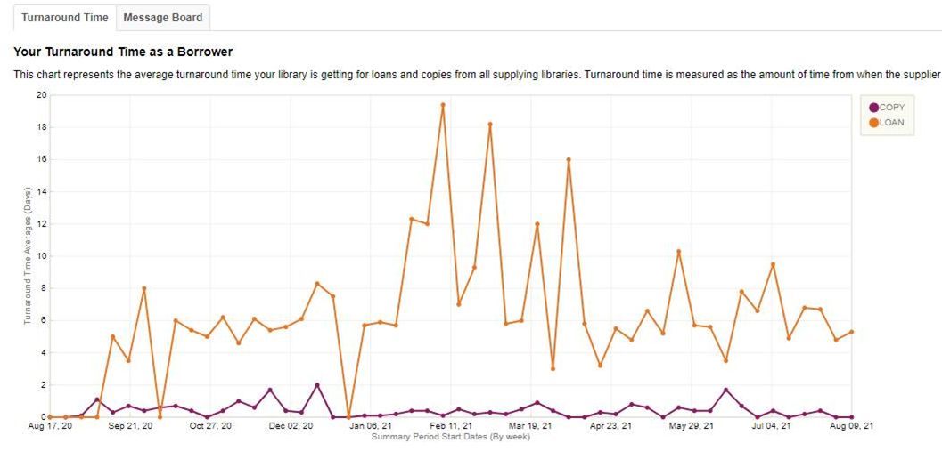
Turnaround time dashboard
Notes:
.

Slide 16
Smart Fulfillment

Slide 17
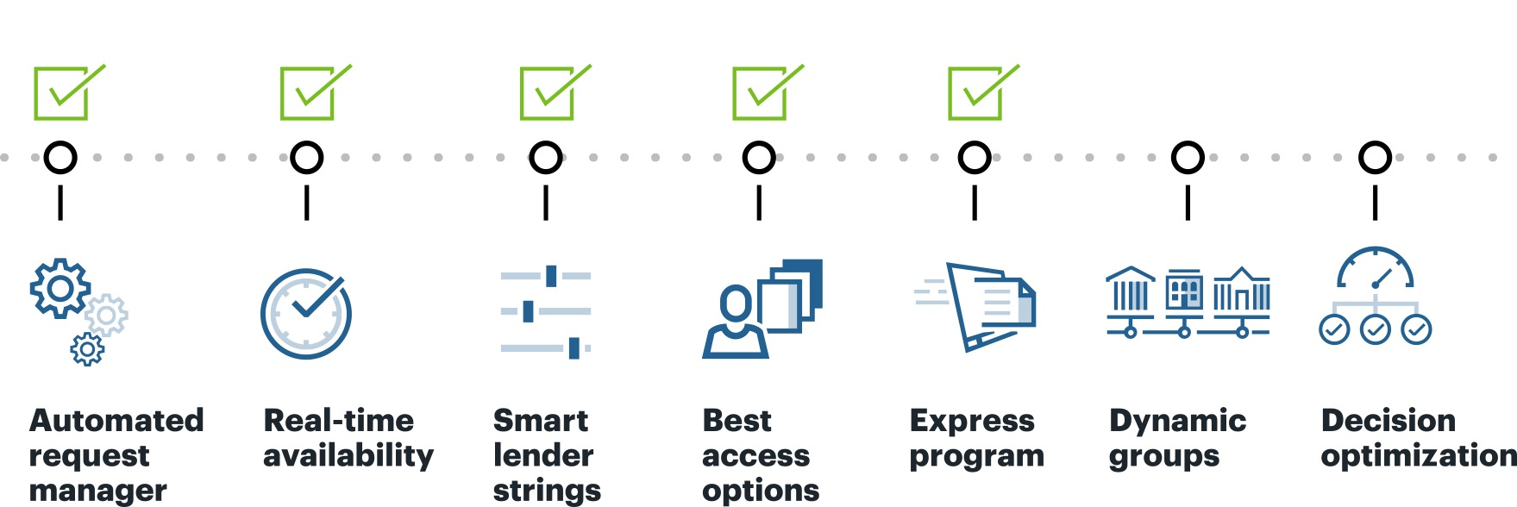
Obtain items for your users faster
with new smart fulfillment capabilities

Slide 18

WorldShare ILL
Automated request manager (ARM)
What is it?
Automates ILL workflows based on library’s configuration
Enables libraries to determine how patron-generated requests are processed
For both borrowing and lending!
HOW DOES IT HELP?
Ensures patrons get resources quickly
Processes more requests faster
Helps staff focus time on more
complex needs
Notes:
.

Slide 19

WorldShare ILL
Real-time availability
What is it?
Connects to a lender’s local catalog to see if an item is on the shelf
Responds "no” automatically if item is checked out or unavailable
Complete this form: oc.lc/realtimeill
HOW DOES IT HELP?
Gets requests to lenders that can supply the fastest
Speeds up borrower turnaround time systemwide
Reduces time as a lender spent looking up item availability

Slide 20
Smart fulfillment: Smart lender strings
What makes a lender string built by automation better than a string I build myself?
Strings built with automation utilize and consider:
  Deflections
  Turnaround time
  Electronic licenses
  Print serial holdings
  WorldCat knowledge base holdings
  Profiled groups in Custom Holdings Paths
GOAL: Faster turnaround times

Slide 21
Smart Lender Strings: How they are built
We call the lenders selected by Automation "smart lender strings” because
ARM has access to more data than your staff interface
It can evaluate the capacity of HUNDREDS of potential lenders to fill each request.
It can remove lenders who would deflect the request,
Sort lenders in each of your groups by turnaround time – while performing load balancing so if a lender is the fastest but currently has a new lending request queue that is much larger than what they typically have, that lender is deprioritized until their workload looks more typical.
Smart lender strings consider LHRs for print serial holdings,
And lender kb holdings, and licenses for electronic materials.
And there is quite a difference in turnaround times between requests handled totally by automation and those where staff manually processed them and created the lender strings.

Slide 22

Smart lender strings: Two requests for the same title
Copy request for articles from Developmental Psychology journal
How was lender string built? | Patron placed request | Request sent to lenders | Request shipped by lender | Position in lender string | Request received at borrowing library | Borrower’s turnaround time
Automation (Library 1) | Friday, 1:53 PM | Friday, 1:53 PM | Friday, 2:07 PM | 1 | Friday, 2:08 PM | 15 minutes
Manually by staff (Library 2) | Unknown | Tuesday, 2:28 PM | Thursday, 11:44 AM | 7 | Thursday, 11:56 AM | 45 hours, 28 minutes

Slide 23

Smart lender strings: two requests for the same title
Loan request for the DVD, A Godwink Christmas: Meant for Love
How was lender string built? | Patron placed request | Request sent to lenders | Request shipped by lender | Position in lender string | Request received at borrowing library | Borrower’s turnaround time
Automation (Library 1) | Thursday, March 4, 1:30 AM | Thursday, March 4, 1:31 AM | Thursday, March 4, 2:27 PM | 3 | Monday, March 8, 9:09 AM | 4 days, 7 hours, 39 minutes
Manually by staff (Library 2) | Sunday, Dec 27, 11:12 PM | Tuesday, January 12, 8:44 PM | Saturday, January 23, 10:30 AM | 5 | Monday, February 8, 10:16 AM | 42 days, 11 hours, 4 minutes

Slide 24

oc.lc/sf-get-started

Slide 25

OCLC’s express Service

Slide 26
The OCLC Express Service
1,000+ libraries
550,000,000+ holdings
20,000,000+ unique holdings
500,000+ copy requests filled in 2022
10-hour average turnaround time
Membership cost = $0

Slide 27
Express: Membership
Libraries that supply copy requests in 18 hours or less are invited to join Express.
These libraries receive an updated list of other Express symbols about three times per year. The list can be used for a super-fast Custom Holdings Group to make fulfillment for your patrons' borrowing requests even faster.
The breadth and depth of Express is impressive:
More than 1000 libraries – who typically do better than the 18-hour turnaround time – most average 10 hours.
And, In case you’re wondering, the group already includes 5 UK libraries who agreed to participate out of the 9 whose turnaround times made them eligible for Express membership.
Being part of Express is available at no additional cost to qualifying libraries.
Express Lenders may still charge per request or not – it is up to their normal working practices

Slide 28
Express: Best practices for borrowing
Create a custom holdings group for Express
Make this group first in the custom holdings path you use to request copies
Set up an automation with automated request manager to speed the process even more
Tipasa libraries
  Turn on Proven Senders so that copies delivered by Article Exchange are automatically received and your patrons notified as soon as the supplier uploads the document.

Slide 29
Express: Best practices for lending
Requires no major changes in your lending configuration or workflows
  No change needed in days to respond
  No change to ILL staffing levels or hours
  No need to check queues on weekends (unless you already do so)
  No policy changes required at all
  Be consistent:
    Check queues frequently (especially copies) and process copies first
    Supply electronically via Article Exchange
    If you cannot supply an article, say “no” quickly; do not let requests linger in your queue

Slide 30
Express: How to join (It’s free)
If you are invited to Express, you don't need to make drastic changes to perform better – you’re obviously providing excellent service already!

Slide 31
SOME UK Specific Items

Slide 32
Requesting from The British Library
No special processing, no need for ARTeMail
Route your requests to the BRI symbol in WSILL or Tipasa
BL automatically pulls the requests into their internal system
BL automatically updates the requests to Unfilled or Shipped
BL invoices your library directly in GBP (Don’t use IFM!)
BL have preset all their UK accounts with the following defaults:
  Copies delivered by unencrypted download
  Copyright set to Library Privilege
  Individual requests can override the default delivery address
NB: To override default copyright include “CCS” in the Borrowing Note.

Slide 33
Off-system Requesting
New functionality introduced last summer allows WSILL and Tipasa users to request from or supply to libraries outside of the OCLC network using email
Libraries can now maintain a private “address book” of their off-system partners, including Days to Respond, email addresses, contact details etc.
Over the next 6 months off-system requesting will be gaining the ability to automatically send the following types of emails:
  overdues to off-system borrowers
  cancellations when off-system lenders take too long to respond or the patron’s need by date expires
  Initial request messages when off-system requests are first submitted

Slide 34
Off-system Requesting
But don’t get too carried away by this new feature.
Please try not to use Off-system Requesting to send emails to:
  a) The British Library -- just route requests to the “BRI” symbol instead – its easier for you and for the British Library
  b) Fellow UK WorldShareILL and Tipasa users – just add them to your lender strings as normal.

Slide 35
ISO 18626: The new ILL Protocol
Request Transfer into WorldShareILL or Tipasa
  Sirsi-Dynix
  Alma
  Innovative
Full Peer To Peer ILL transactions
  Alma Coming Soon

Slide 36
UK Public Libraries
During 2023 the 100 or so UK public libraries currently using the UnityUK system will be migrating to WorldShareILL or Tipasa.
This means that the 30 or so UK academic libraries using WSILL or Tipasa will be able to interlend with those 100 UK public libraries all within their WSILL or Tipasa.
This should result a healthy decrease in the number of email requests request that you get from these libraries, since they’ll be able to request from you directly via WorldShare ILL.

Slide 37


