Slide 1
FIL Online February 2023-
British Library Update
Jo Cox- Key Account and Business Support Manager

Slide 2


Service Disruption
Notes:
1.
Apologise for disruption caused by taking down BLOD for 2 separate periods in January
Essential Server upgrades for security reasons
2.
And Thank you for your patience during this time.
We still have one more small upgrade but are confident we can keep the service running for that one.

Slide 3

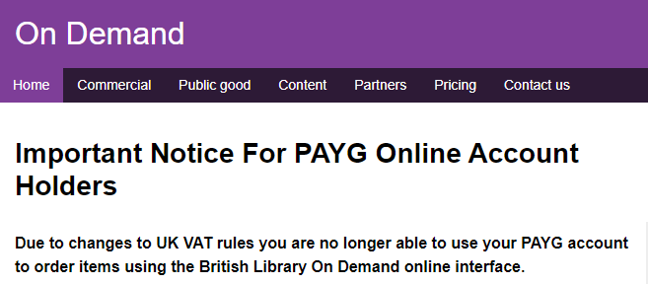
General Service Updates - 1
Pay As You Go Changes
Overseas Library Privilege

Slide 4
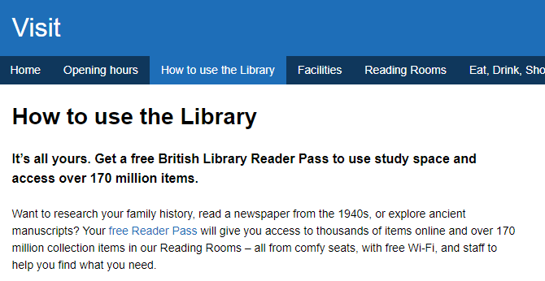

General Service Updates - 2
Reader Registration Changes
Reading Room Usage

Slide 5

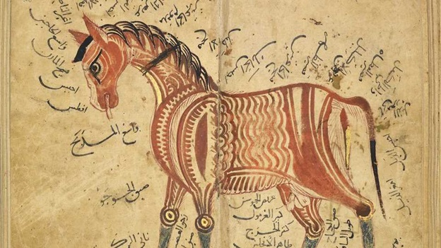
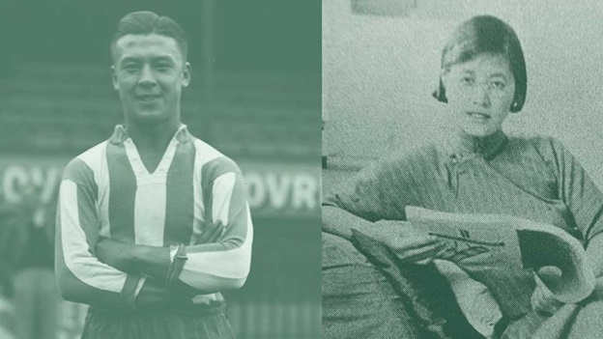
General Service Updates - 3

Slide 6

Happy 50th Birthday!

Slide 7
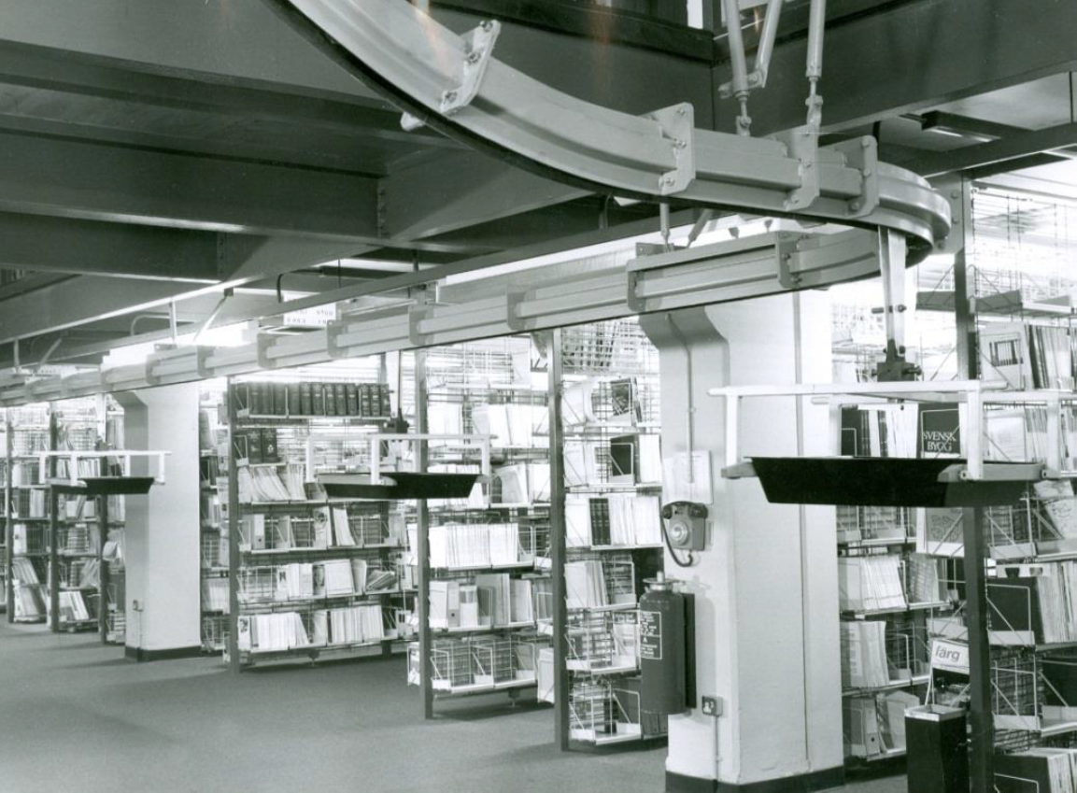
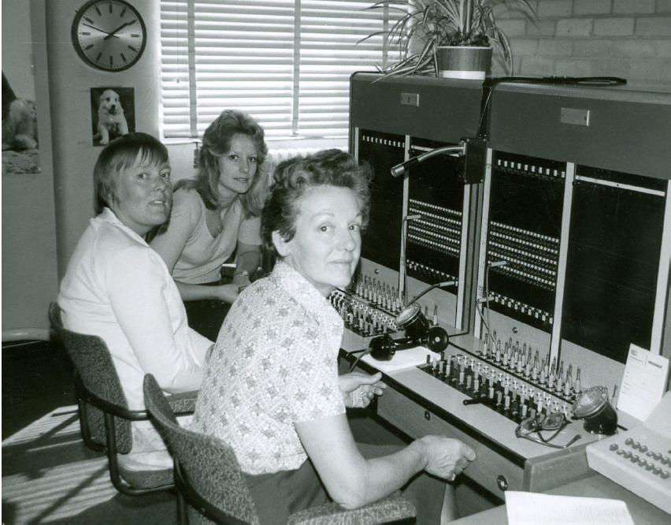
From the Past…
Notes:
Gate House (back of the site
Reception (doesn’t look that much different now!
One of the first computers
Switchboard
The BL advancing knowledge- mentions compact discs
My favourite- This is a Chain conveyor that moved books around. Head height at up to 60ft a minute.

Slide 8
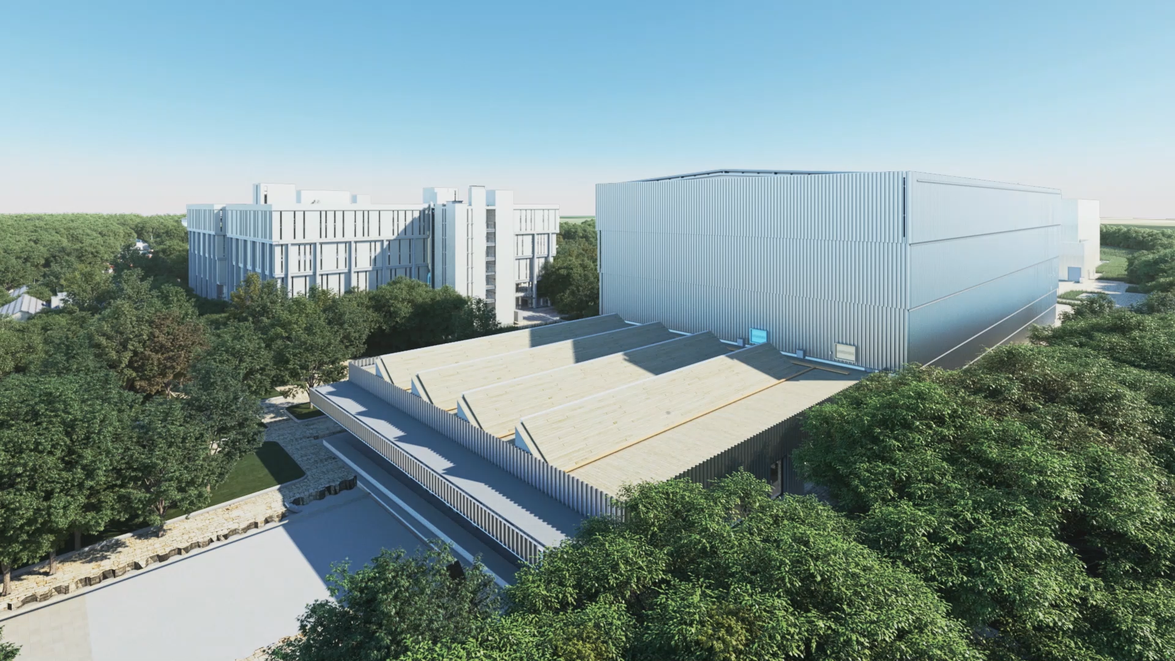
To the Future…

Slide 9
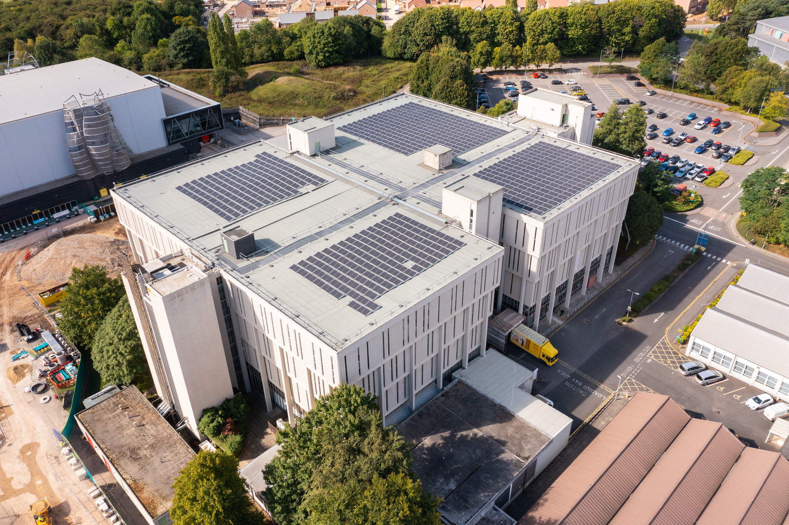
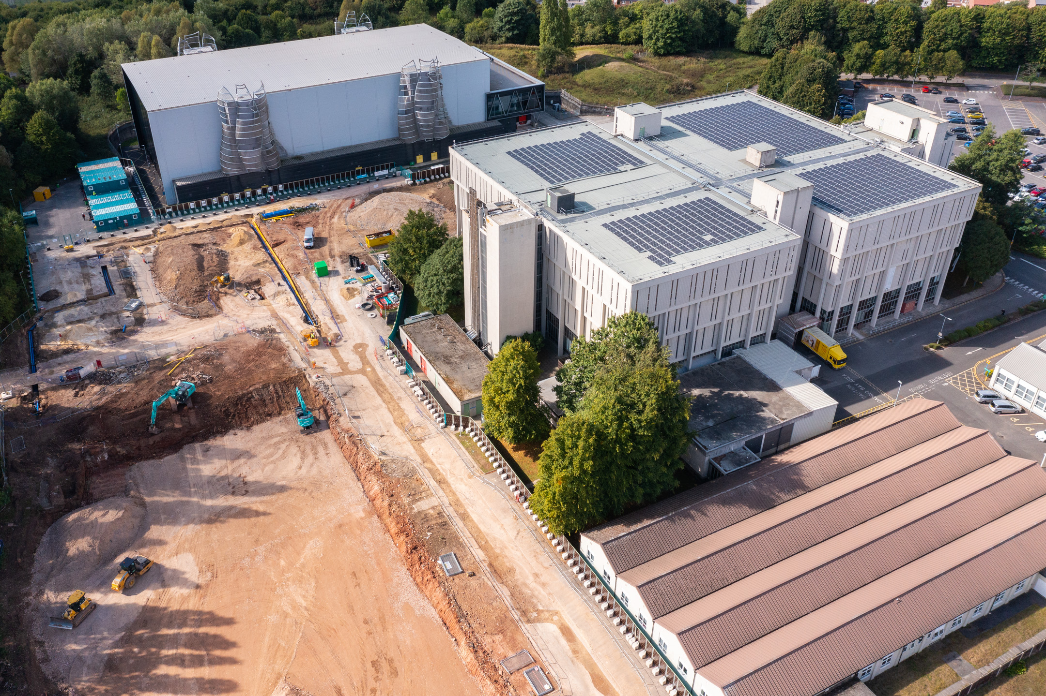
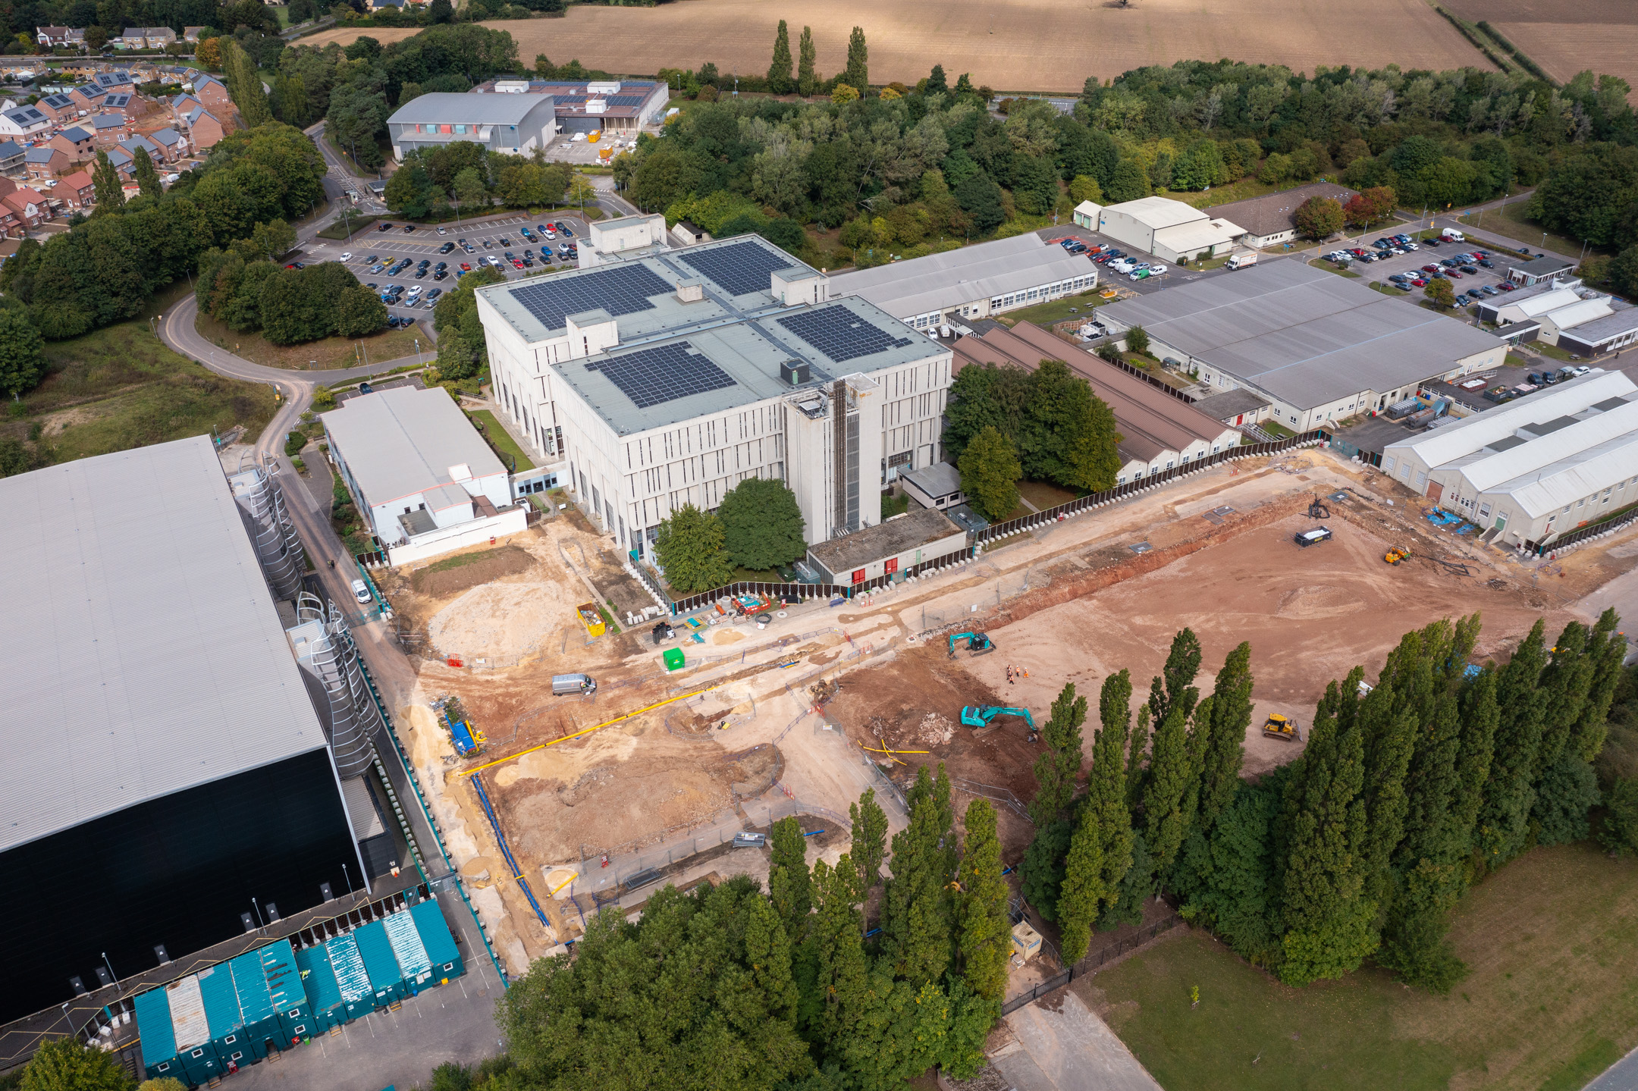


Slide 10
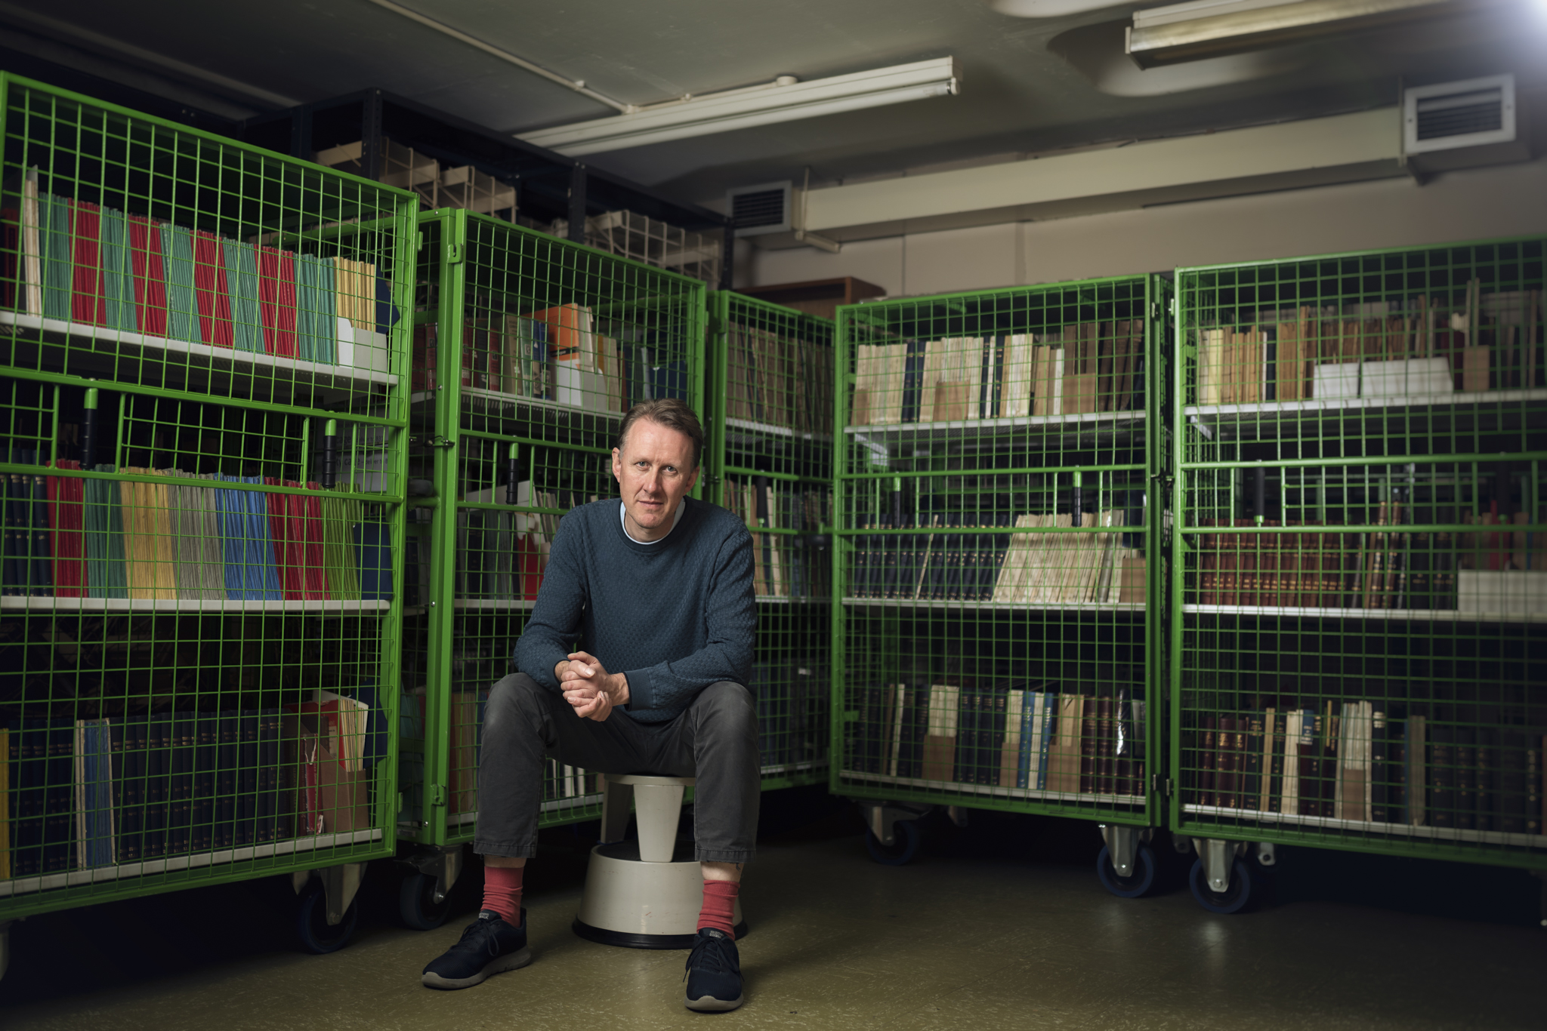

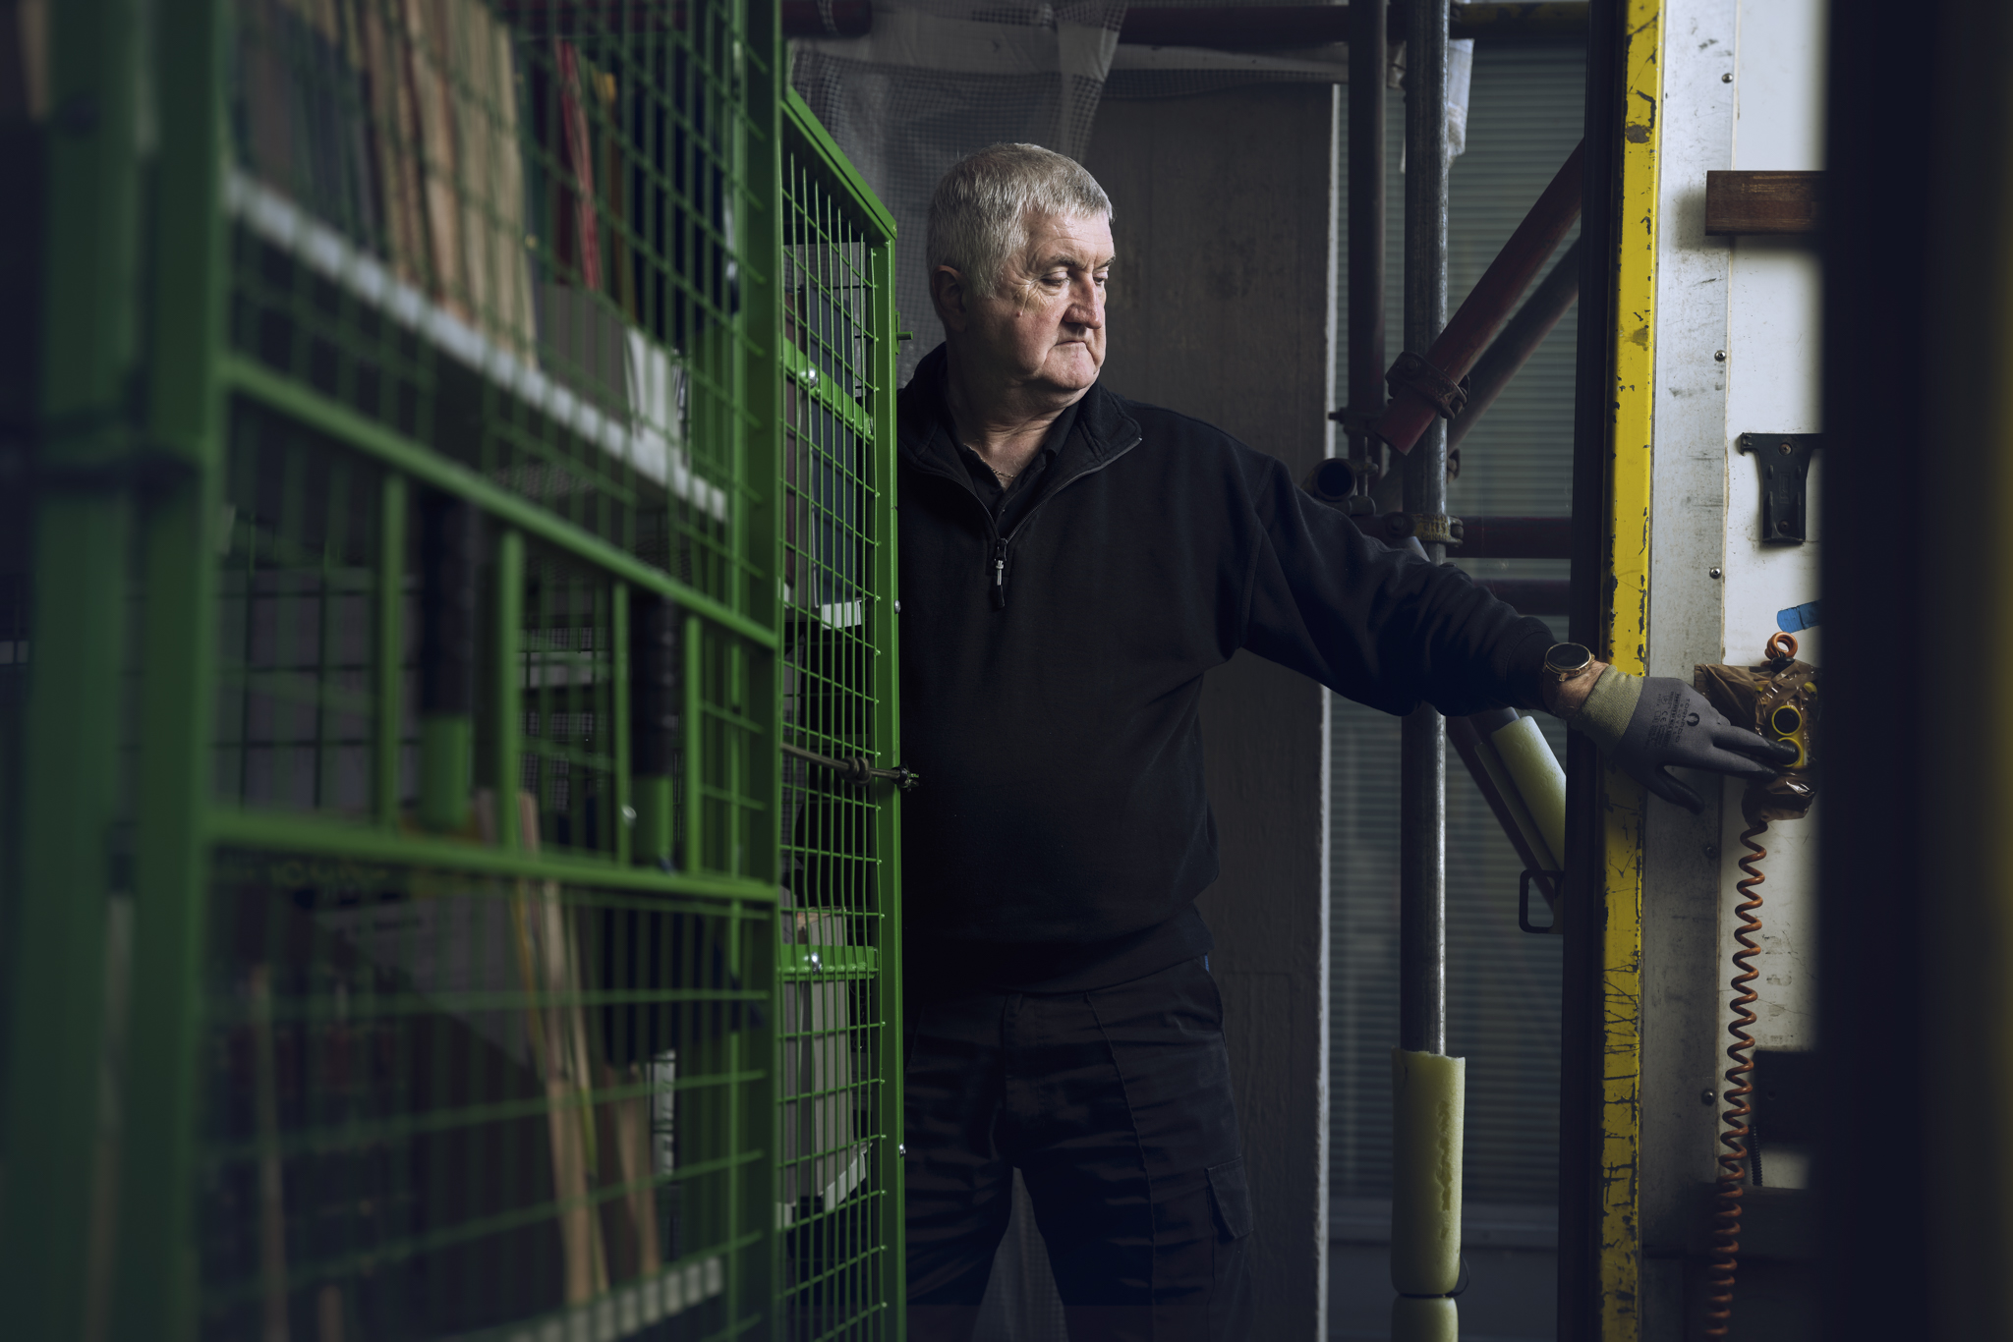
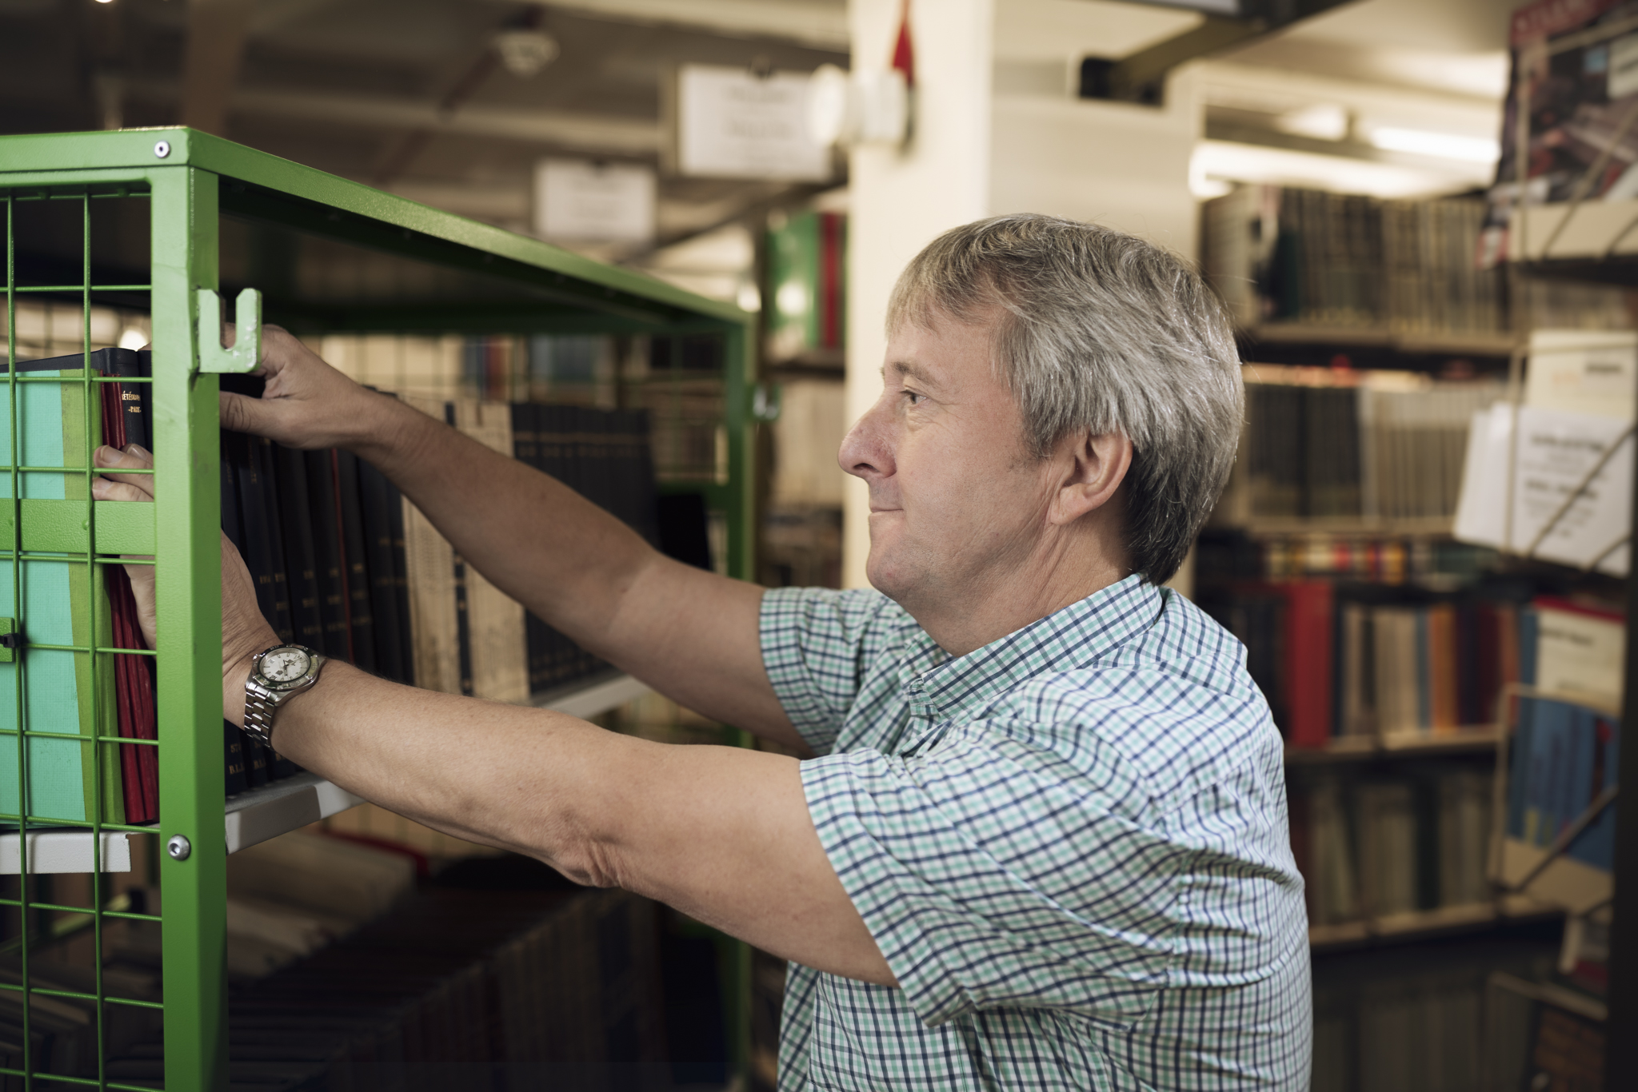
Collection moves
… in advance of refurbishment
103km of collections were relocated by the Boston Spa Team and Contractors
(50km into ASB - 13km offsite - 40km ‘shuffled’)

Slide 11
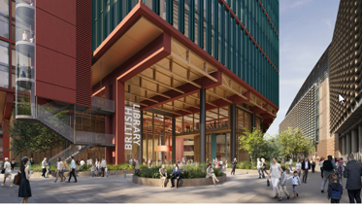
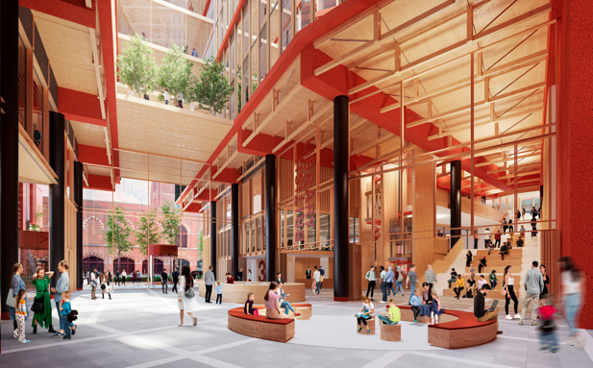
St Pancras Transformed

