Slide 1
RapidILL – workflows Implementing and Integrating RapidILL into Alma at University of Edinburgh
Carl Jones
(University Collections Facility & Document Delivery Supervisor)
Carl.Jones@ed.ac.uk
Notes:
Good morning. Pleasure to be starting this year’s Interlend conference. A two part presentation between University of Edinburgh (Alma) and of University of East Anglia (Aleph/ Worldshare Tipasa).
Talk a little bit about RapidILL for the benefit of those who either know nothing about or have never used RapidILL.
Following on from previous presentations including Phil Sykes- University of Liverpool who talked at great length about RapidILL last year, when less UK institutions were using the system.

Slide 2
Notes:
Want to highlight Edinburgh’s experience using Rapid ILL with Alma and how our processes have changed since 2020.

Slide 3
Year | Library Management System | ILL System | RapidILL
2015
2016
2017
2018
2019
2020
2021
2022
Notes:
Have used Alma since Summer 2015, but continued to use OCLC’s ILLiad client in lieu of Alma’s Resource Sharing until early 2020 and began using Alma Resource Sharing just before lockdown.
Not able to provide physical services during lock down but offered digital Borrowing and Lending for the majority of the lockdown period.

Slide 4
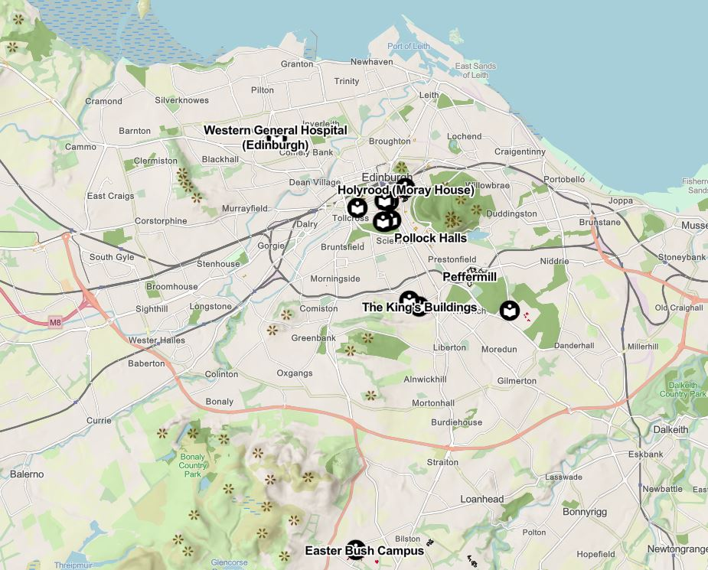
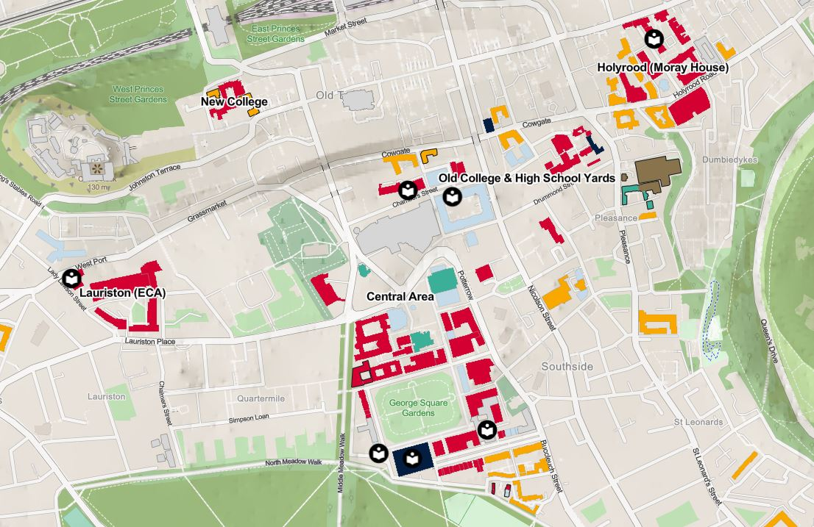
Notes:
Edinburgh has a multi-site library set-up (a Main Library, 9 site libraries and an off-site store)
ILLiad had five Resource Sharing “libraries” in the client – central area and four specific libraries.
Alma Resource Sharing reduced this to one single Resource Sharing Library, with all staff processing requests from one list. Beneficial for digital requests as document delivery to users is not tied to a physical location, so not necessary for site specific staff to handle their own users’ requests.

Slide 5
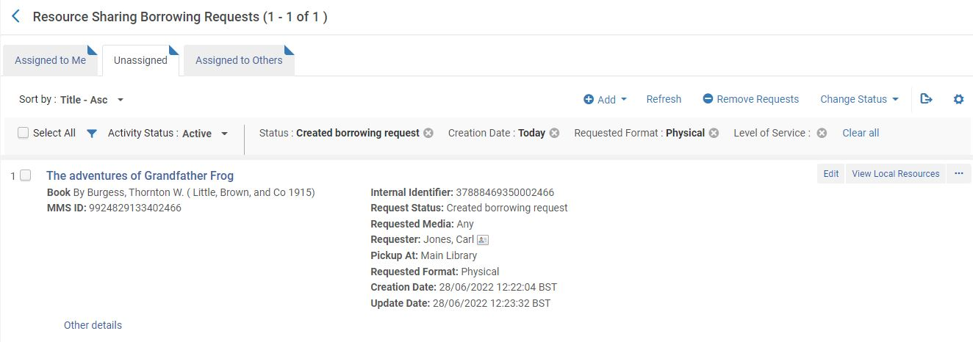
Notes:
Disadvantage of Alma (before RapidILL): lost the peer-to-peer requesting functionality of ILLiad (which is replicated in OCLC Worldshare).
Borrowing requests come to us directly, inside Alma…

Slide 6
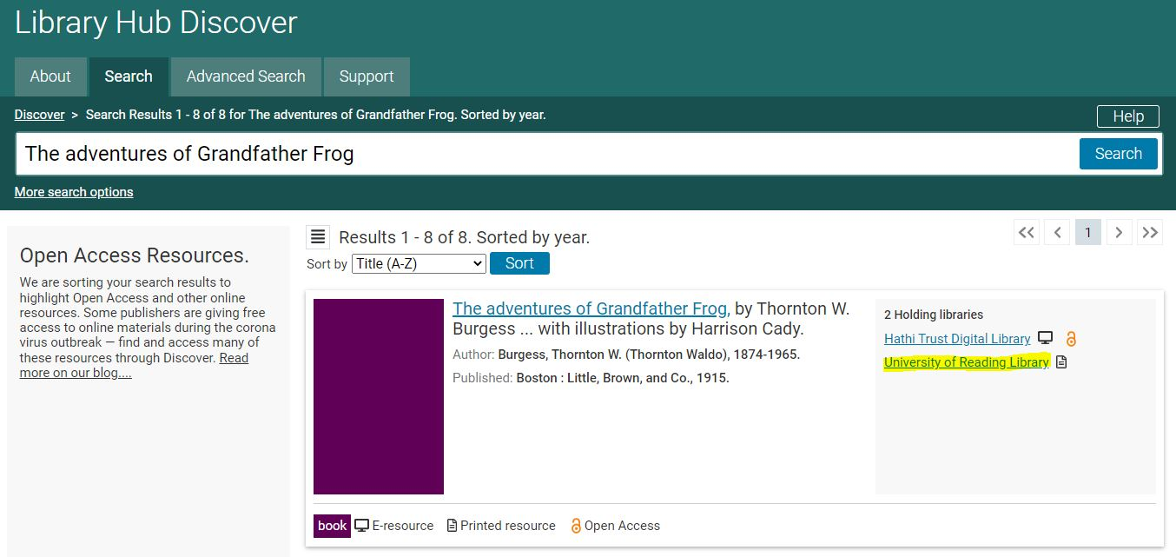
Notes:
… but catalogues must be searched manually and a “rota” of “Partners” assigned.

Slide 7
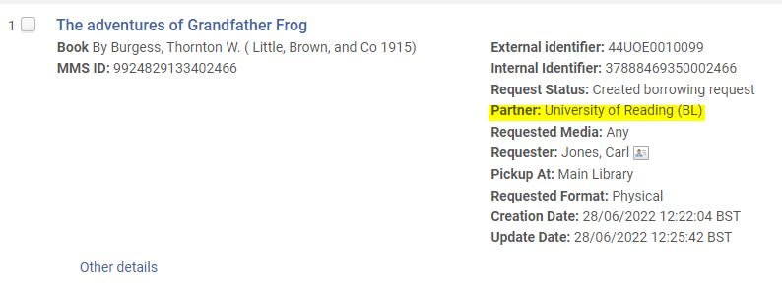
Notes:
Alma acts as an emailing tool rather than contacting Lenders through the system.

Slide 8
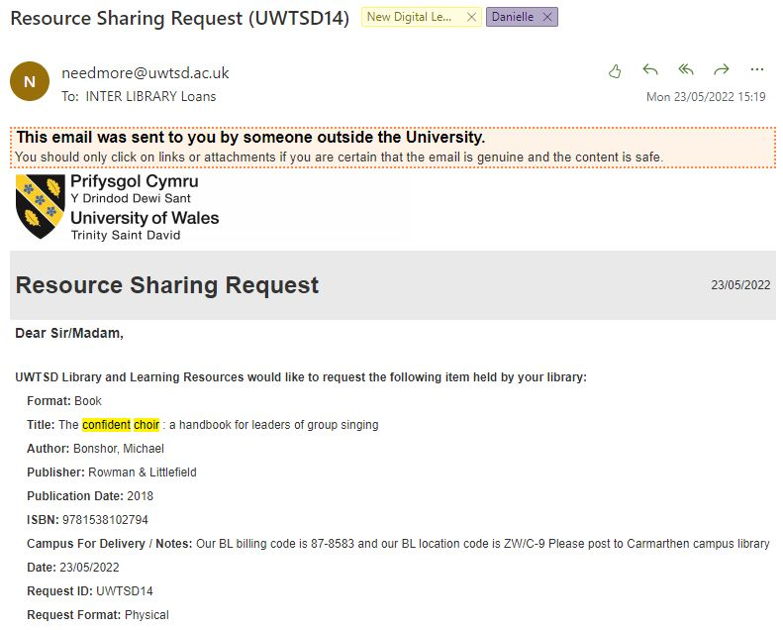
Notes:
Lending even more manual process. Requests arrive via email and must be inputted manually into Alma.

Slide 9
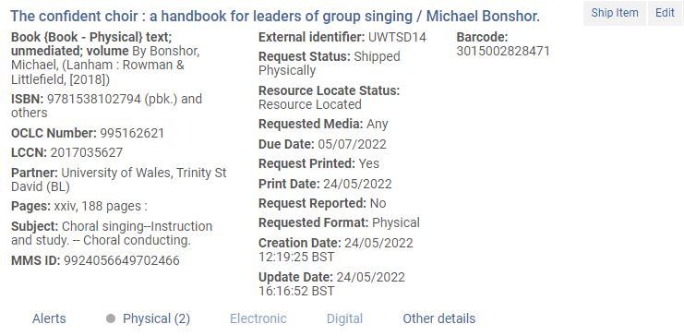
Notes:
…

Slide 10
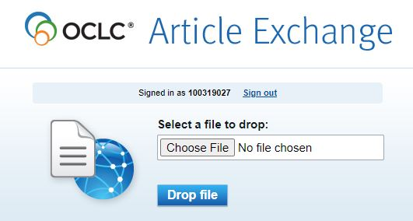
Notes:
Documents are also manually uploaded by us and delivered via Article Exchange (file delivery tool) using our OCLC subscription.
Big advantage to user is that books are received and circulated/borrowed in one system/one library account.

Slide 11
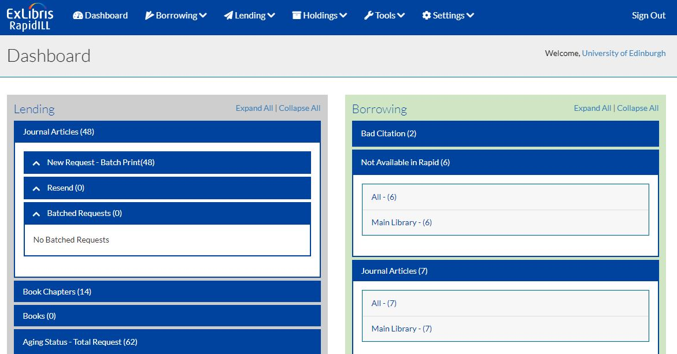
Notes:
RapidILL was created in 1997 and is now owned by ExLibris since 2018.
A standalone, web-based document delivery system that integrates with many library management systems, including Alma.
As well as fast turnaround times, borrowing works on a reciprocal basis with no transaction charges or invoicing costs among the RapidILL network.
Also, offer optional automated borrowing requesting and delivery.
In October 2020, the first 5 UK institutions adopted RapidILL. 46 institutions currently in the UK “pod”.

Slide 12
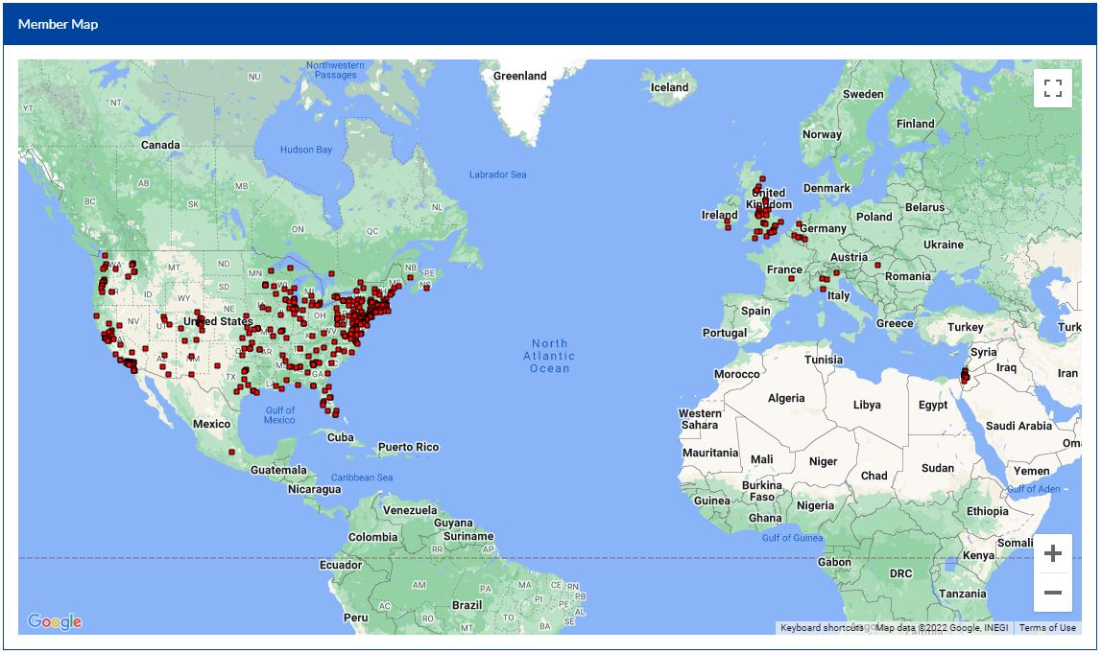
https://rapid.exlibrisgroup.com/Public/MemberMap
Notes:
RapidILL Member Map

Slide 13
A sign displayed on the lawn of West Dennis Library in Massachusetts, on March 18 2020.John Tlumacki/The Boston Globe/Getty Images
Notes:
Many institutions took advantage of RapidILL during the lockdown as a means of enhancing the speed and availability of articles and chapters to their readers.
Like many, our involvement with RapidILL was linked to the UK-wide N8+ Test, designed to trial a UK-based document delivery consortium that would compensate for a hypothetical cancellation of electronic subscriptions, with RapidILL as the common delivery tool.
Began using RapidILL from Jan 2022

Slide 14
Source: “RapidILL Onboarding,” Lynn Higgins, Customer Onboarding Manager (RapidILL) [Oct 28, 2011]
Notes:
We began Integration in November 2021, when we knew we would be part of the N8+ test.
An initial meeting is arranged with RapidIL staff and relevant members of your team, and you are assigned a Customer Onboarding Manager.
Timeframe for integration is a few weeks – Borrowing as short as a few days, and Lending a bit longer due to uploading of holdings to complete.
Communication and tracking of milestones is managed via Basecamp, with guidance, training and videos documented. Training is self-managed.
Initial set-up and integration with Alma was quite straightforward, and handled by our Systems Librarians. Most time consuming aspect was adding journal and book holdings to RapidILL database, needed for Lending, and setting the Lending statuses.

Slide 15
Date
Oct 2021 | RapidILL integration begins
Nov 2021 | Training and set-up/Holding sets creation
Dec 2021 | N8+ set-up & Christmas vacation
Jan 2022 | N8+ Test
Feb 202 | Borrowing goes live
Mar 2022 | Lending live but no requests (issue with sets)
Apr 2022 | Lending requests received (further issues with portfolio ID/MMS ID)
May 2022 | Lending working normally
Notes:
Problems: Onboarding was rather slower for us than expected. A separate Holdings load was required for the N8+ testing so we opted to prioritise set-up for the testing in January and took part in that before we were fully using RapidILL.
We were able to go ahead with Borrowing after the conclusion of the N8 test, but we had problems with our Holdings upload that meant our start date for Lending kept getting pushed back.
We went live with Lending at the beginning of March but did not receive any requests until the start of April, due to the configuration issues. Eventually, we re-uploaded our publishing profile from scratch, which worked and finally became full Lenders from May 2022.
We are now using RapidILL as part of our ILL workflow.

Slide 16
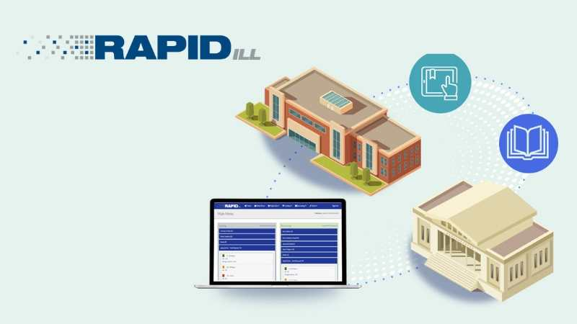
Image taken from https://exlibrisgroup.com/products/rapidill-interlibrary-loan/
Notes:
In this section, I’m going to cover:
Our basic workflow
How we share information among our team
How we train
We are a very small ILL team, with currently no full time member of staff working solely on ILL. But we are a very busy service [University of Edinburgh ILL handles approximately14,000 internal and external requests per year], so we do get help from other library assistants in other teams, and at our site libraries.
This means that we have a lot of people working on requests who only occasionally do ILL work, and don’t always know how the whole process works as they only handle some aspects. It also means that we need robust workflows, which are live documents and can be changed and updated with service statuses easily, especially when we are short-staffed as we have been recently.
Rapid has revolutionised the way we handle requests, as it means we have moved from manually processing each digital request as it comes in to putting it through Rapid as default, and then handling Bad Citation or difficult requests as and when necessary.
The basic Rapid workflow we use is as follows:

Slide 17
Notes:
1. Pick up the request as it comes in through our online form, as a Created borrowing request, like this example here

Slide 18
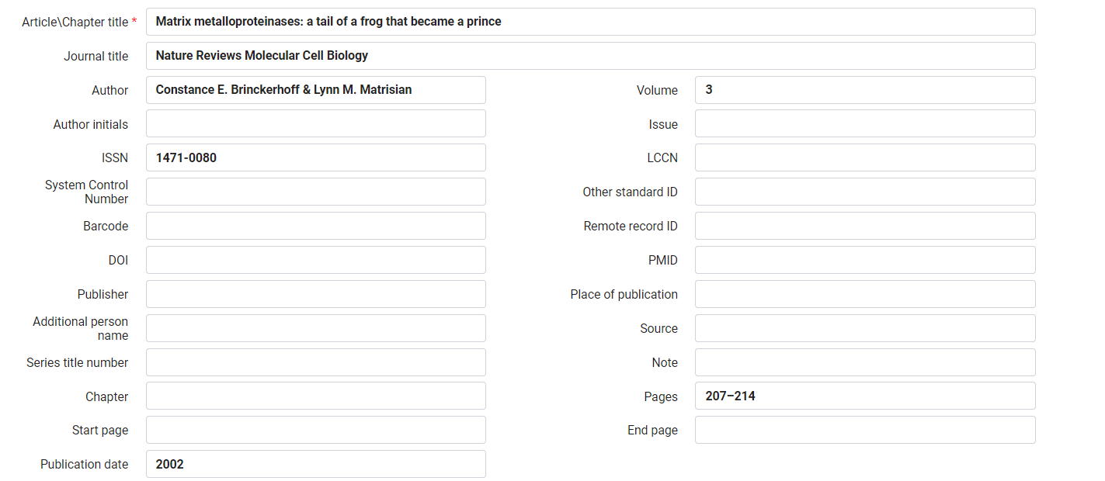
Notes:
2. Edit the request to make sure all necessary information is entered:
a) Article Title, Journal title, Volume, Date, Pages

Slide 19
Notes:
b) And most importantly ISSN, which is often not provided the by the patron
3. Note that book chapters can also be requested this way, with the slightly different book form…

Slide 20
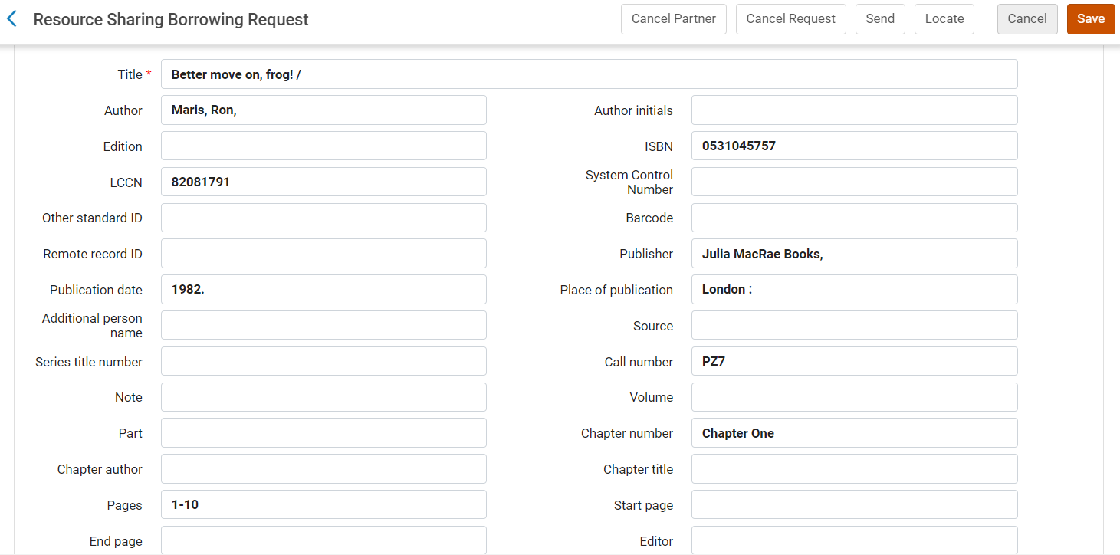
Notes:
c. Now ISBN and Chapter Number should be included, instead of ISSN, volume etc.
We then use Alma’s rota feature, which is how we populate a list of partners for the request to be sent to

Slide 21
Notes:
5. And add RapidILL as a partner

Slide 22
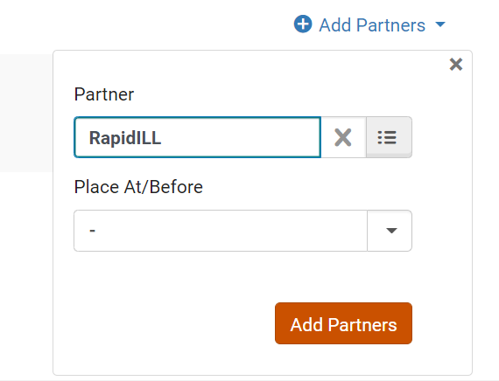
Notes:
6. And it’s that easy! We can then send off the request

Slide 23
Notes:
Rapid checks our local holdings to see if the journal or book in question is listed on our catalogue, in which case an error message will appear. If the system is incorrect (for example, we don’t hold full text of the article needed), we can override this

Slide 24
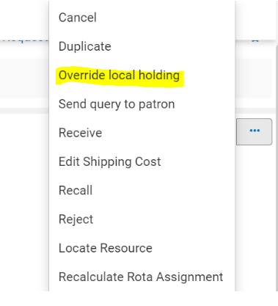
Notes:
There are some other errors that can occur, for example if Rapid cannot match the ISSN or ISBN, or if a partner cannot find the request as cited down the line. These errors result in either the active Bad Citation status …

Slide 25
Notes:
… or the inactive rejected by partner status.

Slide 26
Notes:
In both cases, we would either fix up the request and re-send it to Rapid, or manually fill the request by adding other partners to the rota.
It should also be noted that when a request is filled though rapid it is sent directly to the patron; there is no need for us to mediate this or do what we did previously, which is manually upload the file to Article Exchange and manually send it on to the user. This saves a lot of time, and errors are minimal.
We are still to automate ILL Borrowing requests from our users direct into RapidILL without staff intervention, but we plan to implement this next.
PAUSE
We also quickly wanted to share how we make changes to our workflows or introduce new methods like RapidILL, as demonstrated here, given our staffing structure.
When we moved to Alma in 2020, while we were all working from home, we started using a SharePoint, connected to our Microsoft Teams feed.

Slide 27
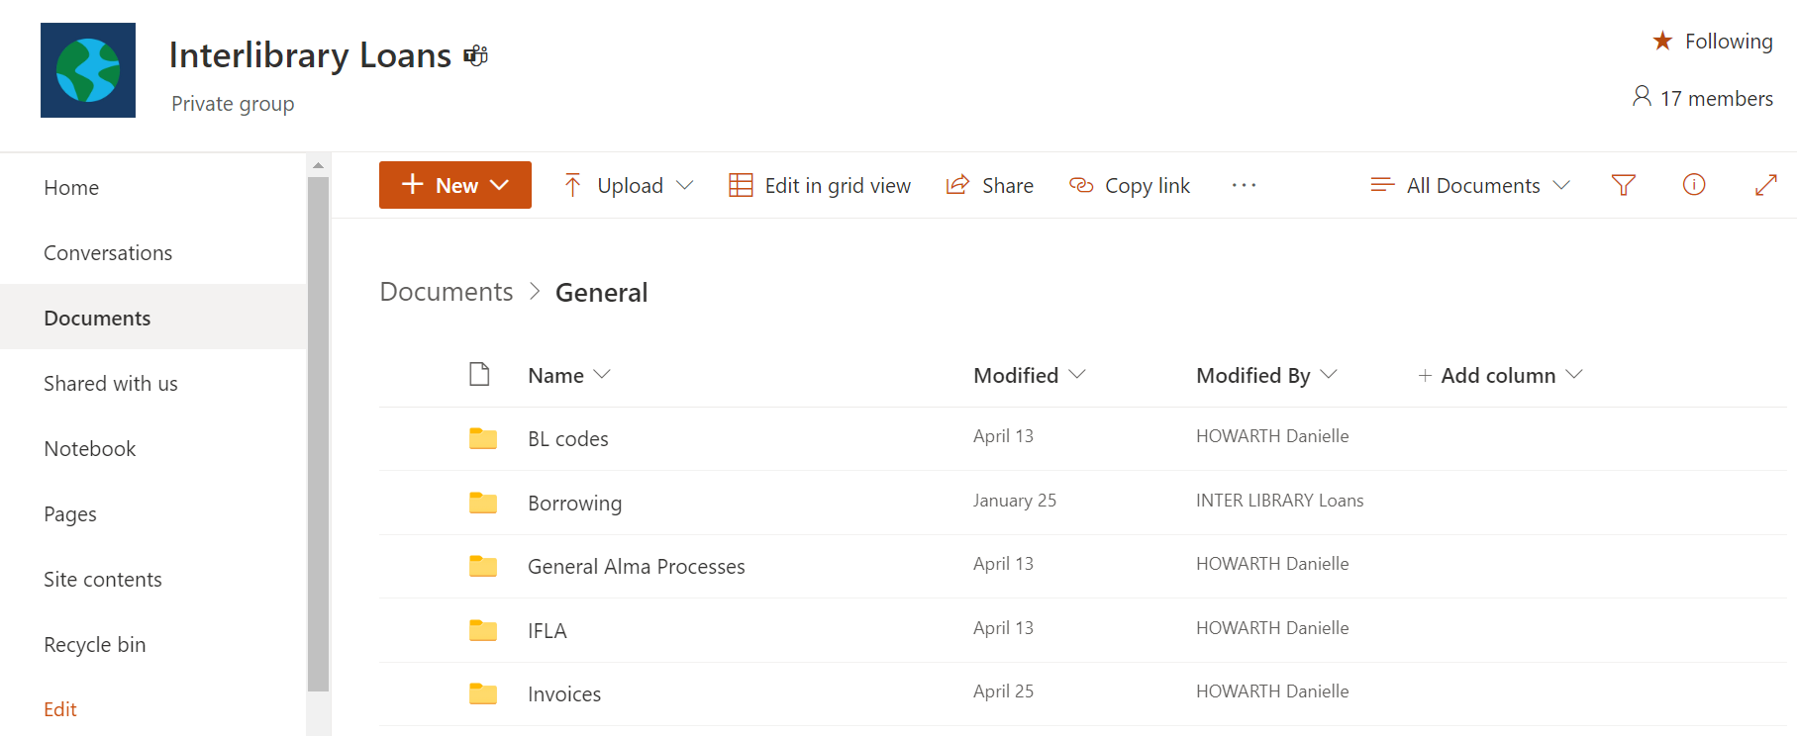
Notes:
Here we collect live workflow documents, which can be changed and updated in real time to make sure everyone is using the most up to date methods and information.

Slide 28
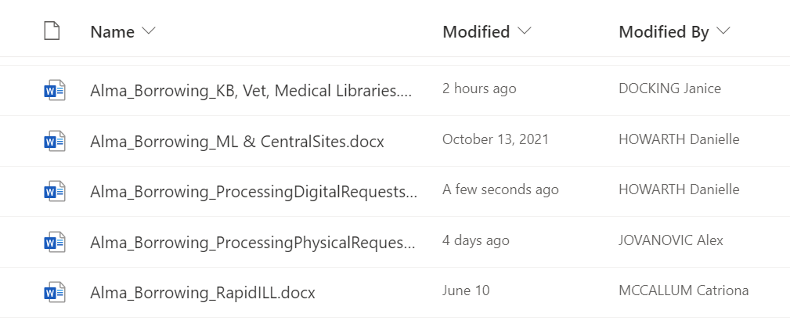
Notes:
Here are some examples of these workflows, and how we divide different processes. As you can see, they are quite regularly updated and added to by a variety of team members.
This is also where we keep a series of training videos, inspired by the excellent presentation given at last year’s FIL conference by Judyta and Ivona from Queen’s University Belfast.

Slide 29
Notes:
This means we can demo processes just the once, and then link new staff members, or staff members who haven’t done our processes for a while, to the videos as a complement to the workflows. This saves time and has been an effective way of communicating changes and improvements like RapidILL.

Slide 30
Notes:
My time is pretty much up so, better move on…

Slide 31
Notes:
But as a final note, a few statistics that demonstrate the extent to which RapidILL has benefitted our service.

Slide 32
13.5
hours
Notes:
In 2022, 1,597 requests have been submitted by us to RapidILL with a fill rate of 93%. A comparable period in 2021, pre-RapidILL, only saw a fill rate of 52.6% for digital requests.
Over the last 3 months, the average supply time for Borrowing requests has been 13.5 hours, but many are filled within an hour and there have been example of some delivered within 1 minute!
Anecdotally, we have found that Rapid is well worth it in terms of the speed and ease of the service. It has greatly reduced the amount of time staff spend dealing with digital requests.
There have been some teething issues, especially with getting used to a “request first, deal with problems later” mindset. But in general, there are fewer problems than we expected with things like bad citations.
[CARL]
Introduce Alison Dyer (Digital Services Librarian, University of East Anglia)
“Rapid ILL and Worldshare”

