Slide 1
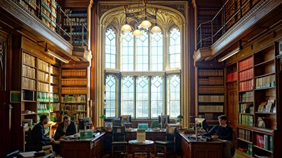
Interlending at the House of Commons Library
By Gregory Howard and Annabel Allen
Wednesday 29 June 2022

Slide 2
The House of Commons Library
The Library Loans Service is one part of the House of Commons Library
We also have a general enquiry service
Many of our enquiries are passed on to the Library’s research sections
The Library’s research is publicly available at https://commonslibrary.parliament.uk

Slide 3
The Library Loans Service
Pre-pandemic, we loaned an average of 200-250 books a month
A quarter to a third of these were interlibrary loans
The number of loans we do has fallen since March 2020, but is increasing again.

Slide 4
Our customers
Members of Parliament
Members’ staff
Staff of the House
Other libraries – reciprocal arrangements

Slide 5
Libraries from which we borrow
House of Lords Library, Westminster Public Libraries, the London Library
Specialist libraries: Chatham House, Supreme Court
Library Hub Discover (COPAC)
WorldCat
Academic libraries around the whole of the UK, public libraries, British Library

Slide 6
Interlibrary loans – administrative details
We keep careful records of the books that arrive on interlibrary loan
Our standard loan period is eight weeks
Each book which we receive on interlibrary loan is recorded on our catalogue.
We do not issue fines for overdue books, but do issue charges for book which are lost.
Effects of the pandemic

Slide 7
Information made available to members of the public
The Library’s website: https://commonslibrary.parliament.uk/
Our most frequently-borrowed books
Transparency and freedom of information requests
Any questions?

