Slide 1
Document Lending & Supply at the British Library
Matthew Lambert

Slide 2
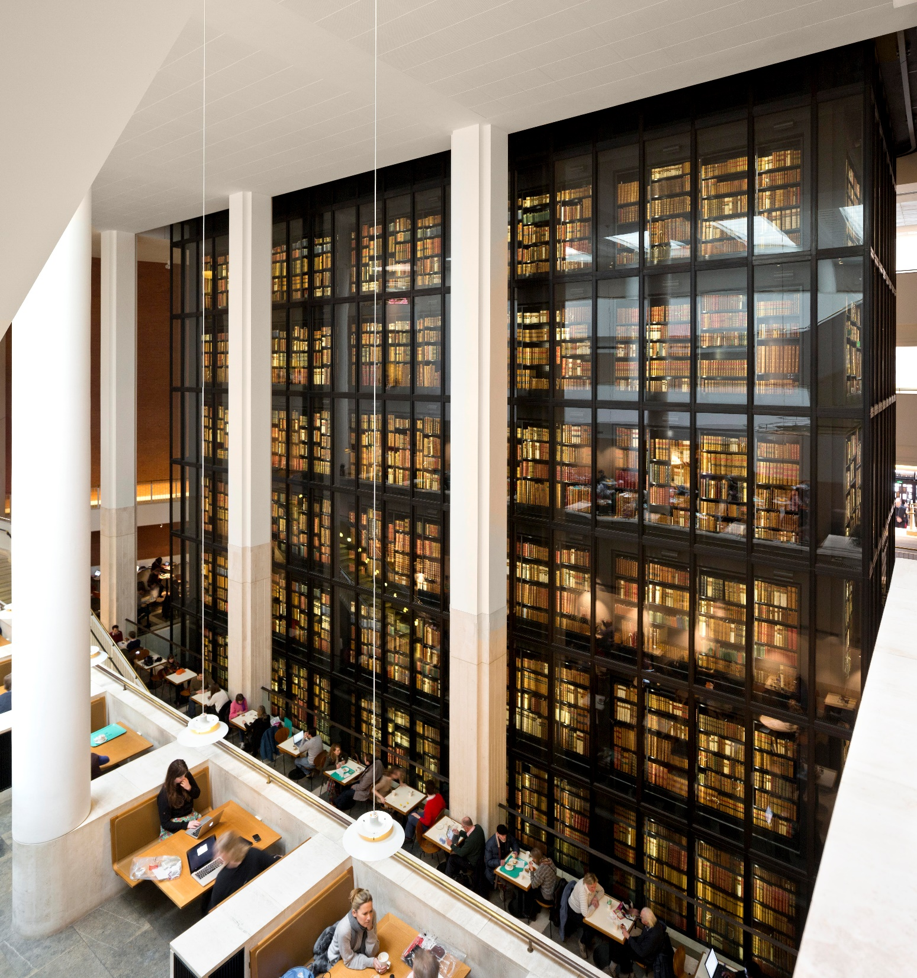
The British Library
National Library
Approximately 180 million items
Legal Deposit Library

Slide 3
Supplying British Library Content
Not just lending – often able to provide copies instead
Separate from users making copies
Several routes depending on use and customer type
Formats – 80% of requests provided electronically

Slide 4
It’s never simple is it…
Legal Constraints
Stakeholder Relationships
Legal Deposit Regulations
Library Systems
Intended use and onward interactions

Slide 5
Many routes to providing content
Accessible Copies
Library Privilege Requests
Copies for Judicial Proceedings
Lending Physical Items
Copyright Fee Paid Copies

Slide 6
Accessible Copies – For Disabled Users
s31A – s31F CDPA
Marrakesh Treaty changes – impact of Brexit…
Legal deposit restrictions
Paperwork requirement to track requests
Pilot of new centralised system
Single dedicated account
Single blanket request form
More transparent pricing

Slide 7
Library Privilege
s42A – s43A CDPA
Restricted to Private Study or Non-Commercial Use
A ‘reasonable amount’ or the whole work
Legal Deposit / Non-Print Legal Deposit restrictions
Declaration – legal requirement
Mechanism – A document supply account required (ordering via BL On Demand, ARTemail, or APIs in library systems)

Slide 8
Judicial Proceedings
Orders via BL On Demand
Though separate account to Library Privilege account as often commercial
Paperwork – BL requirement, not legislative

Slide 9
Lending
We only lend from our Document Supply Collection (used to be known as national lending collection)
So not all our collection can be borrowed - Legal Deposit collection is especially restricted
Have had to implement cut-off date to avoid damaging older items
Order via usual document supply routes
Order numbers have been dropping
Currently no e-lending – we’ve received insufficient interest in it so we haven’t developed systems and platforms to enable this

Slide 10
Copyright Fee Paid
Not copyright issues, instead contractual
British Library is able to do this as a part of agreements with publishers
Fee passed on to publishers
Useful when uses fall outside of ‘non-commercial’ or ‘accessible’
Works with CLA license

Slide 11
In Summary – Who, What & How…
There are lots of ways we can lend or supply items
There are three key questions:
Who is it for?
What is it going to be used for?
How much is needed?
Knowing that will define what the most appropriate route is.

Slide 12
Thank you matthew.lambert@bl.uk

